Slide 1
Moving Towards Inclusive Advocacy: Building Disability Power

Slide 2
Defining Disability

Slide 3
How Do You See and Talk About Disability? Where is the Power?
Medical model
Moral model
Charity model
Inspirational model
Legal/civil rights definitions and model
Social model definition

Slide 4
Ableism
Ableism is discrimination against people with disabilities, and those perceived as having disabilities
Ableism is structural. It is part of the world we live in
People with disabilities can be ableist and/or experience internalized ableism
Discrimination against Deaf people is specifically called “audism”

Slide 5
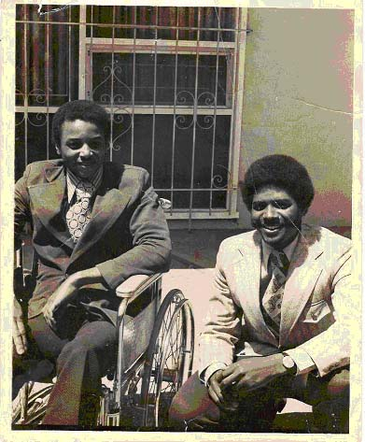
Disability as a social justice movement

Slide 6
Core Strands of the Disability Movement*
Independent Living
Self Advocacy
Psychiatric Survivors
Neurodiversity/Autistics
Parents
Legal Advocates/Rights Advocates
Disability Justice
*These are some of the strands, not all!

Slide 7
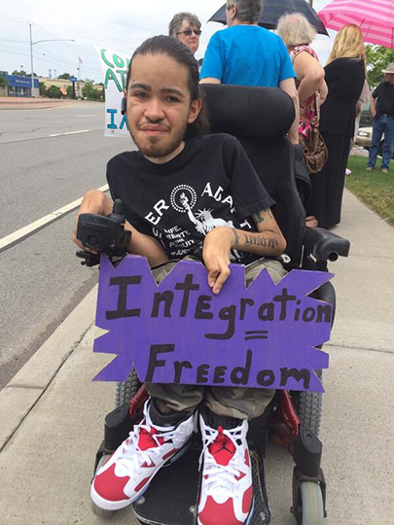
A Word on ADAPT
Local chapter has met at Access Living since 1983
Key role in fighting attacks on Medicaid
Core issue: home and community based services as a civil right
Undergoing leadership shift

Slide 8
Disability justice

Slide 9
10 PRINCIPLES OF DISABILITY JUSTICE
INTERSECTIONALITY
LEADERSHIP OF THOSE MOST IMPACTED
ANTI-CAPITALIST POLITIC
COMMITMENT TO CROSS-MOVEMENT ORGANIZING
RECOGNIZING WHOLENESS
SUSTAINABILITY
COMMITMENT TO CROSS-DISABILITY SOLIDARITY
INTERDEPENDENCE
COLLECTIVE ACCESS
COLLECTIVE LIBERATION
SOURCE: Sins Invalid, www.sinsinvalid.org

Slide 10
Learning More About Disability Justice
Disability Justice Lesson Plan by Lydia X.Z. Brown
Leaving Evidence blog by Mia Mingus
Care Work book by Leah Lakshmi Piepzna-Samarasinha
Books by Eli Clare: Brilliant Imperfection, The Marrow's Telling , and Exile and Pride
Naomi Ortiz book: Sustaining Spirit: Self-Care for Social Justice

Slide 11
Access Living Then and Now….
Since 1980, Access Living has seen several evolutions in social justice approach
We currently strive for supporting disability justice and building cross-movement solidarity
New strategic plan focuses on racial equity and cross-disability work

Slide 12
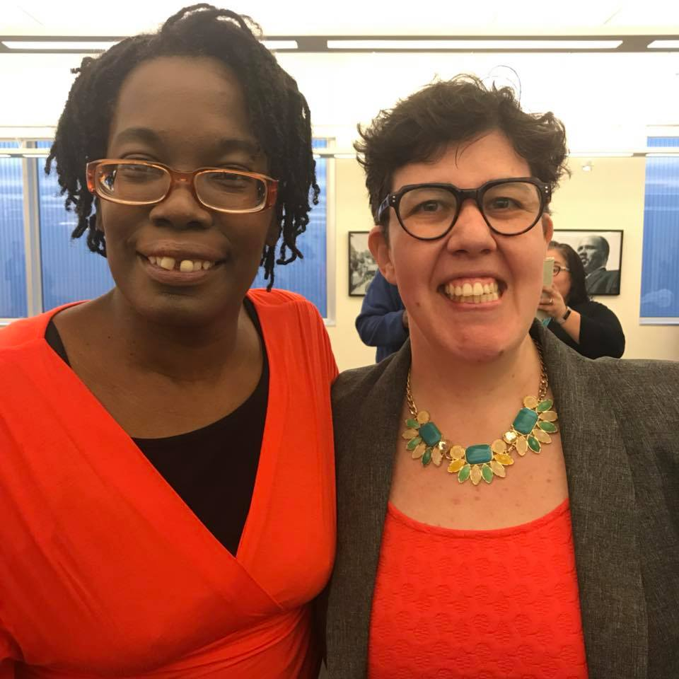
Advocacy at access living

Slide 13
Advocacy Processes at Access Living
Services
Organizing
Policy
Legal
Media

Slide 14
Advocacy Topic Areas at Access Living
At any given time, Access Living may be addressing the following issue areas:
Housing
Transportation
Healthcare/Home and Community Based Services
Racial Justice
Education
Criminal Justice System/Emergency Response
Immigration
Reproductive Justice
Government Accountability

Slide 15
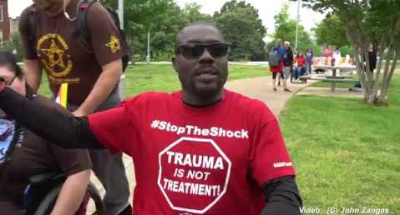
Current issues in disability advocacy

Slide 16
Spotlight: Healthcare is #1
This week is the 54th anniversary of Medicaid and Medicare
Healthcare for all must include what people with disabilities need
Healthcare must be nondiscriminatory (Section 1557 of the ACA)
Drug prices
Access to supplies and equipment in a timely fashion
Being bureaucratized to death (see Carrie Ann Lucas and Bill Peace)
Healthcare should include those without documentation or those off-grid
Healthcare in jails and prison

Slide 17
Sample Federal Disability Bills
Disability Integration Act
Disaster Relief Medicaid Act
Real Emergency Access for Aging and Disability Inclusion for Disasters Act (REAADI)
Transformation to Competitive Employment Act
See other legislative priorities at www.ncil.org

Slide 18
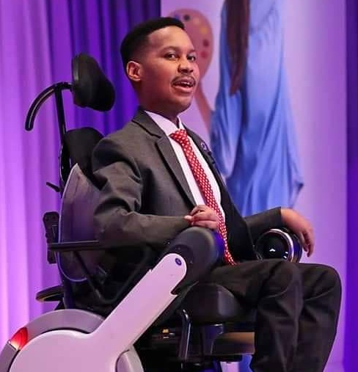
Take a Look at the Work of These Groups…
National Disability Rights Network (Protection and Advocacy Agencies)
Disability Rights International
Human Rights Watch Disability Rights Division
UN Sustainable Development Goals

Slide 19
Contact information
Access Living website www.accessliving.org (in process of revision, relaunch in August)
Amber’s email address: asmock@accessliving.org

