Slide 1


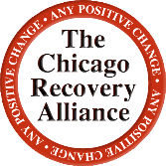

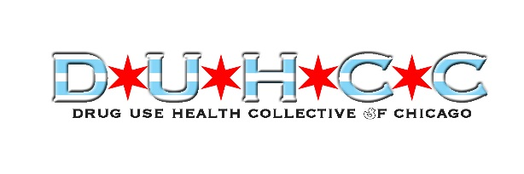
Overdose Prevention Sites and Harm Reduction
Suzanne Carlberg-Racich, PhD, MSPH

Slide 2
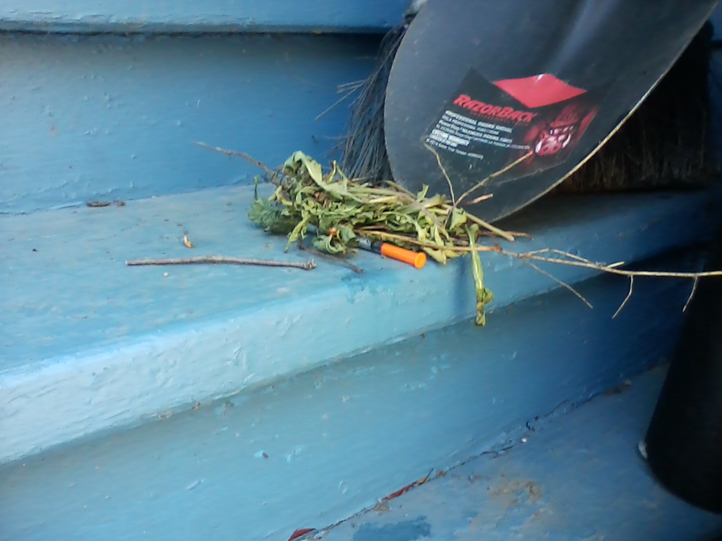
Public Injection perpetuates individual and community-level risk for Hepatitis, HIV and other harms
Clients of SCS report alarming risks associated with public injection, including sexual violence against women (Jozaghi, Reid & Andresen, 2013), physical violence, theft, and forced sharing of drugs or money (Jozaghi, Reid & Andresen, 2013; Wood et al, 2007)
Photo by CRA Participant

Slide 3
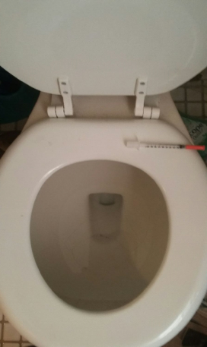

Fear of arrest, the risk of overdose, and the need for privacy, lighting and water drive people to other venues

Slide 4
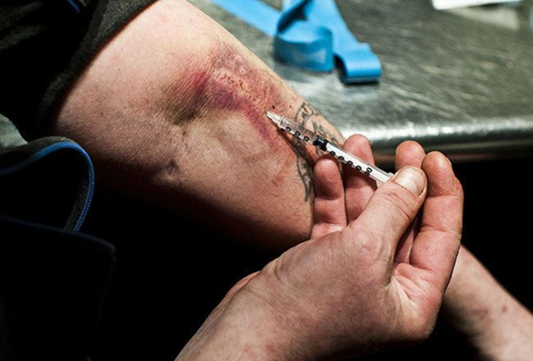
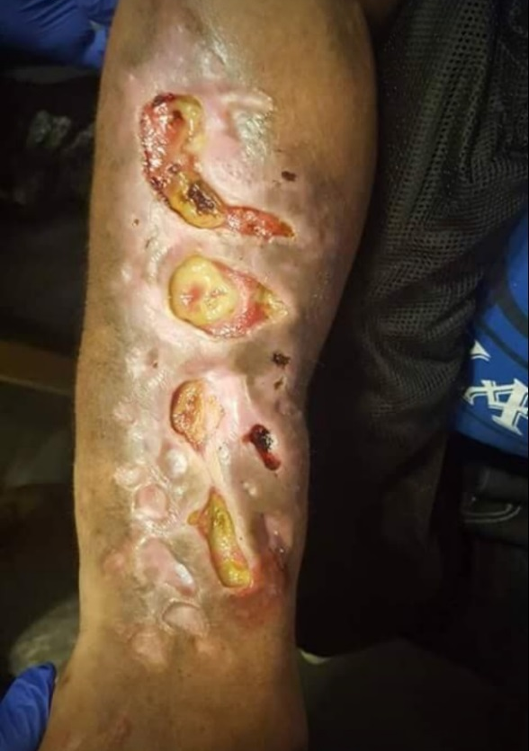
PWID experience pervasive, ongoing stigma
This stigma is associated with poorer health outcomes
PWID are less likely to access medical, mental health, and social services
Photos by CRA Participants

Slide 5
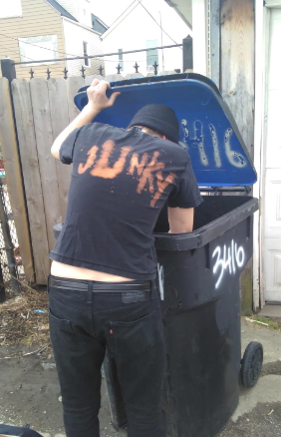
I feel like I’m marked. Because I inject drugs, it’s as if I’m contagious. People don’t want to get to know me or get too close.
As a result, I feel like the lowest form of life, forced to live off of what others throw away.
I’m not good enough to fully indulge in all that being part of a community entails.

Slide 6
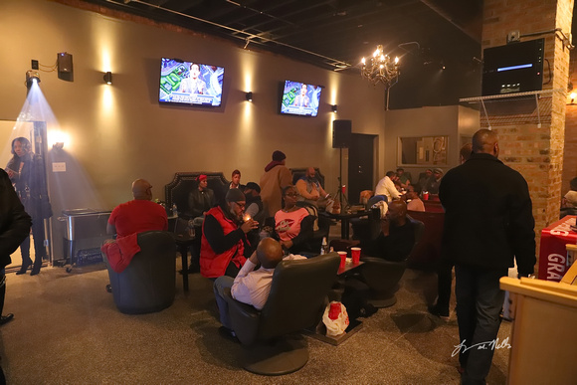
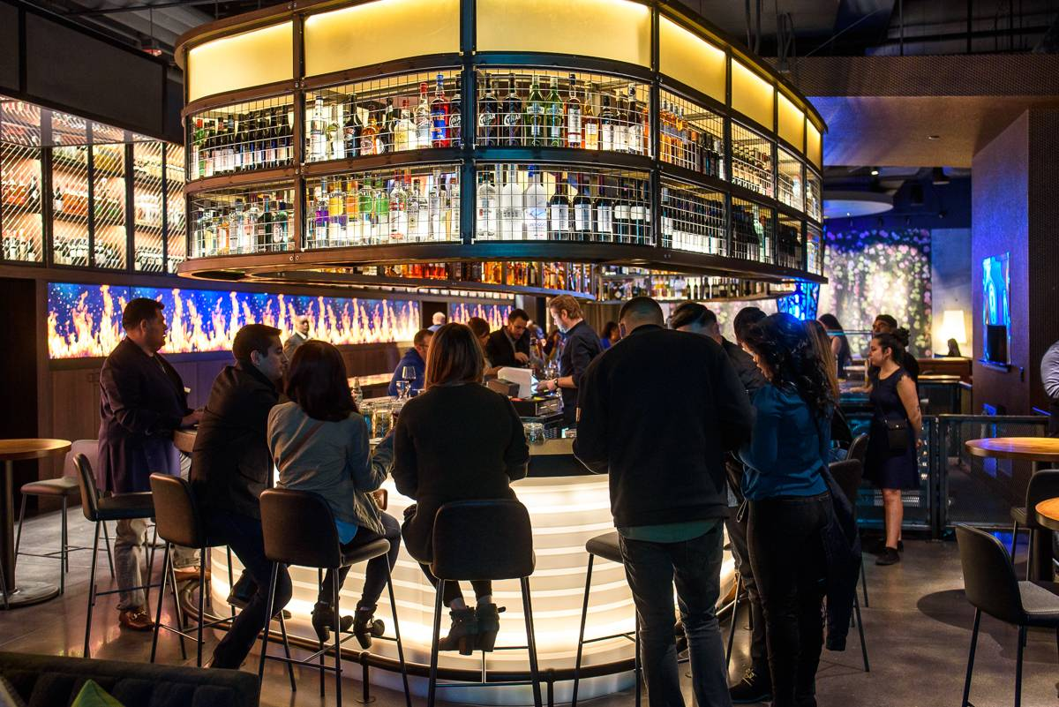
Sanctioned Consumption Spaces in the U.S.

Slide 7

Sanctioned Consumption Spaces
Communal
Protected (elements, police)
Respect individual bodily autonomy
Are varied to facilitate choice
NOT designed to facilitate life and health, but to sell alcohol and tobacco products

Slide 8
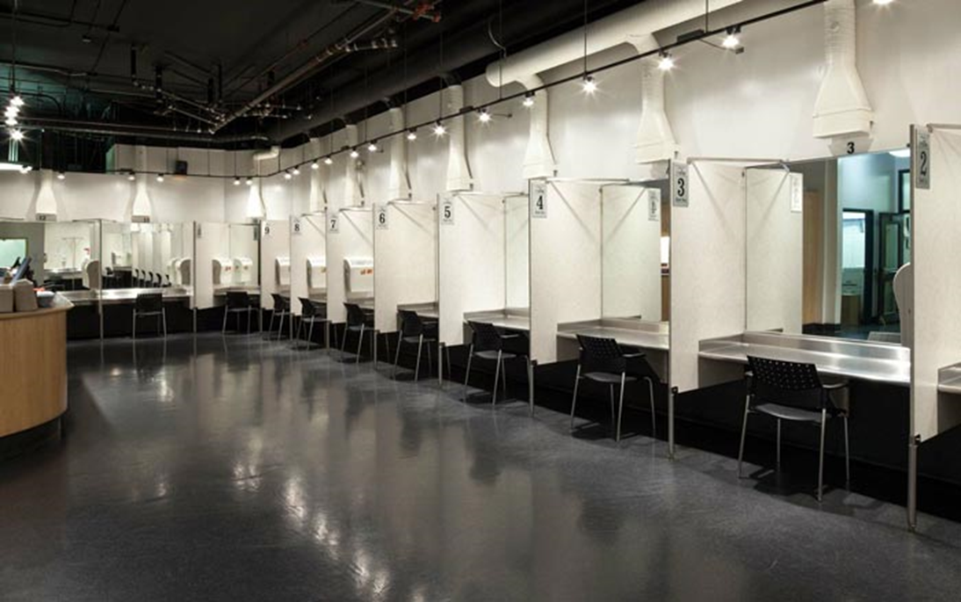
Public Health Outcome #1:
Less Risk
75% of clients at Insite shifted to less risky injection behaviors (Bayoumi & Strike, 2012), and 23% stopped injecting altogether (Petrar at al., 2007).
Clients in several programs reduce sexual risk (Dolan et al, 2000; Milloy et al, 2010; Hedrich, Kerr & Dubois-Arber, 2010), including:
  Increases in condom use with steady partners
  Increases in condom use with casual partners
  Increases in consistent condom use

Slide 9
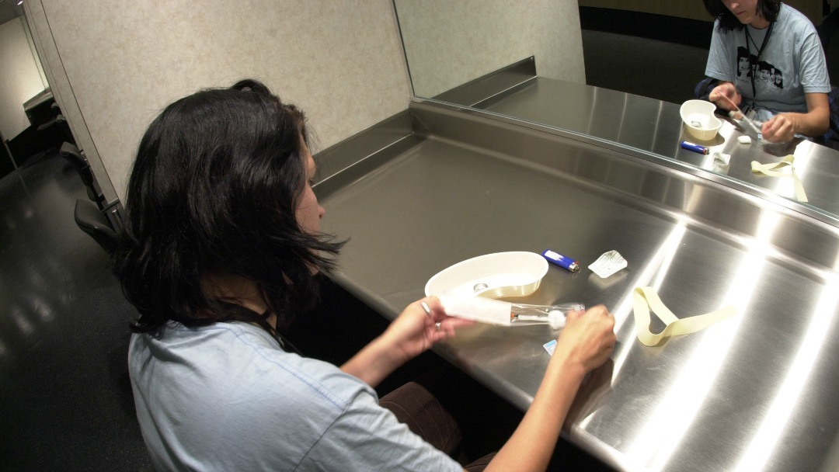
Public Health Outcome #2:
A reduction in morbidity
Over 1,100 HIV infections averted at Insite over a 10 year period (Otter, 2008)
Decreases in HIV & HCV infections, and soft tissue infections (Marshall et al, 2011; Wood et al, 2006; Kerr, 2005; McKnight et al, 2007; Milloy et al, 2009; Milloy et al, 2008; Stoltz et al, 2007)

Slide 10
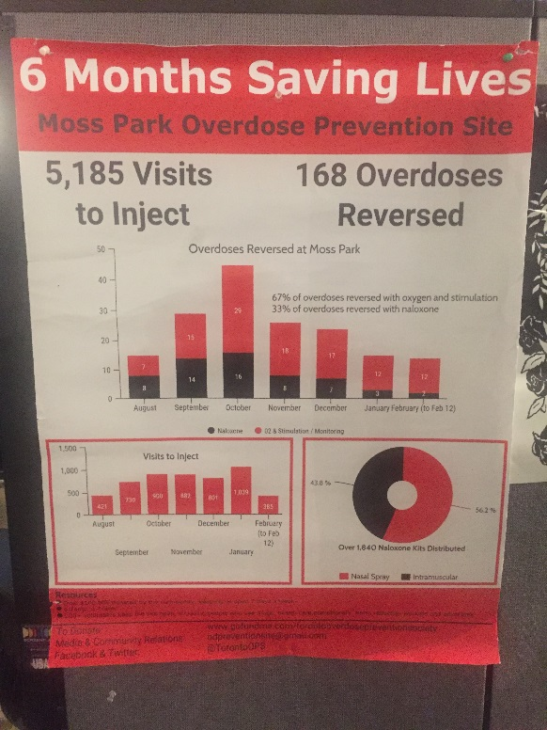
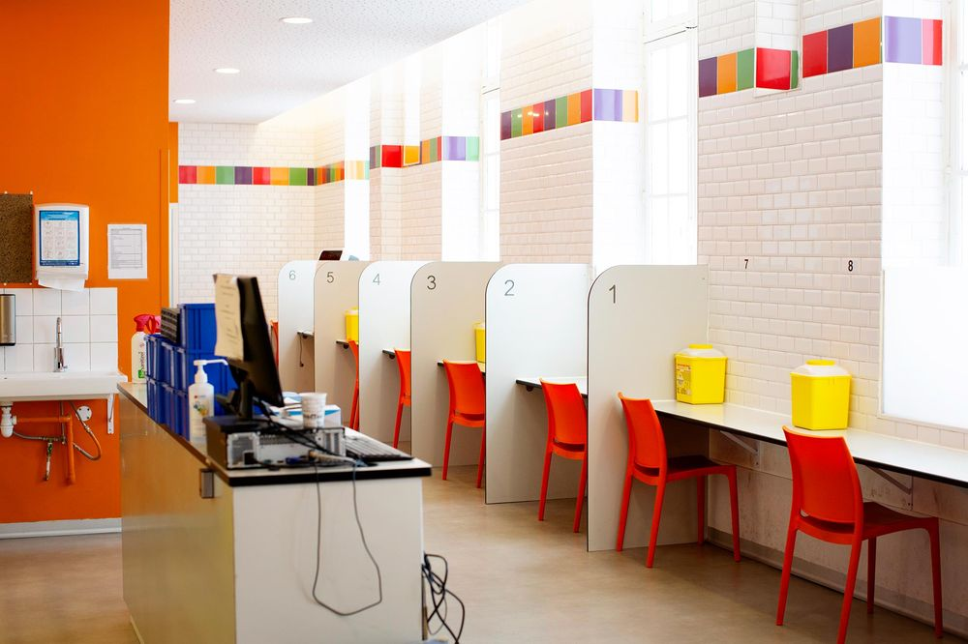
Public Health Outcome #3:
A decrease in overdose mortality
Overdose mortality fell 35% in the immediate area surrounding Insite, and only 9% in the rest of the city (Marshall et al., 2011); and in sites across Europe (Dolan et al., 2000)

Slide 11
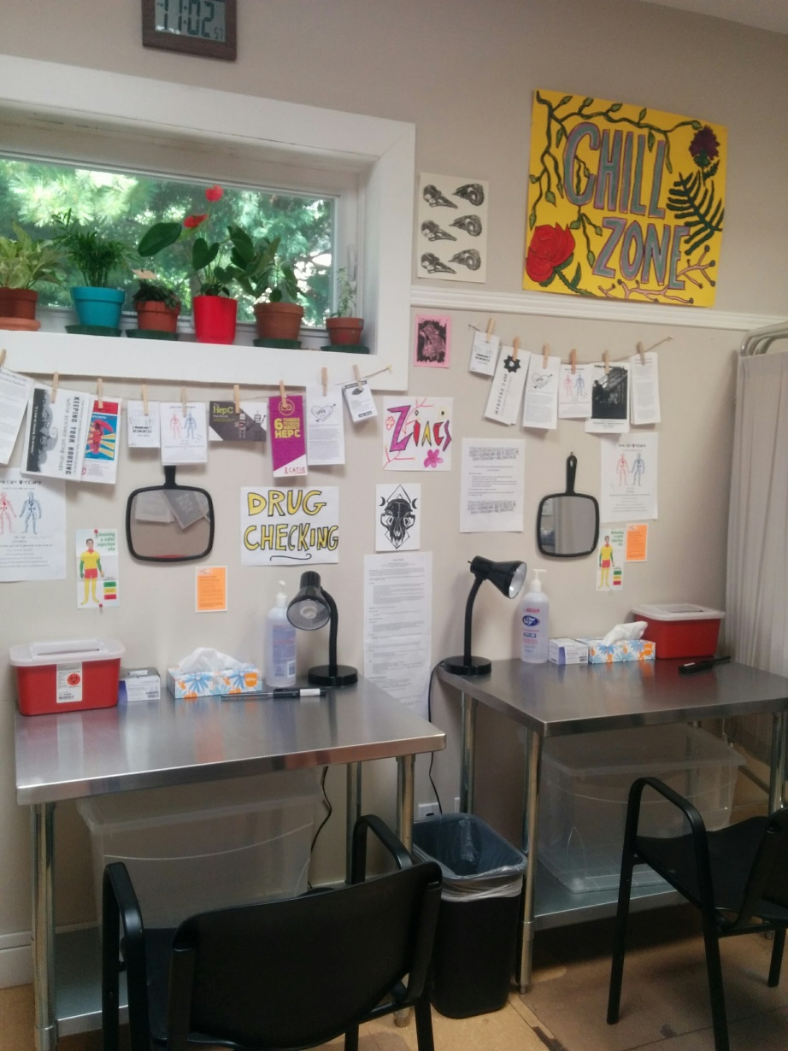
Reduction in Premature Deaths
Those who might benefit from SIF services experience high rates of premature death
SIF attendance on a weekly or greater basis is associated with a lower risk of premature death from any cause
Photo Credit: Zoe Dodd
Notes:
This finding remains even after adjusting for common confounding variables (age, sex, housing instability, HIV seropositivity, daily injection, public injection, incarceration, enrollment in treatment, etc.)

Slide 12
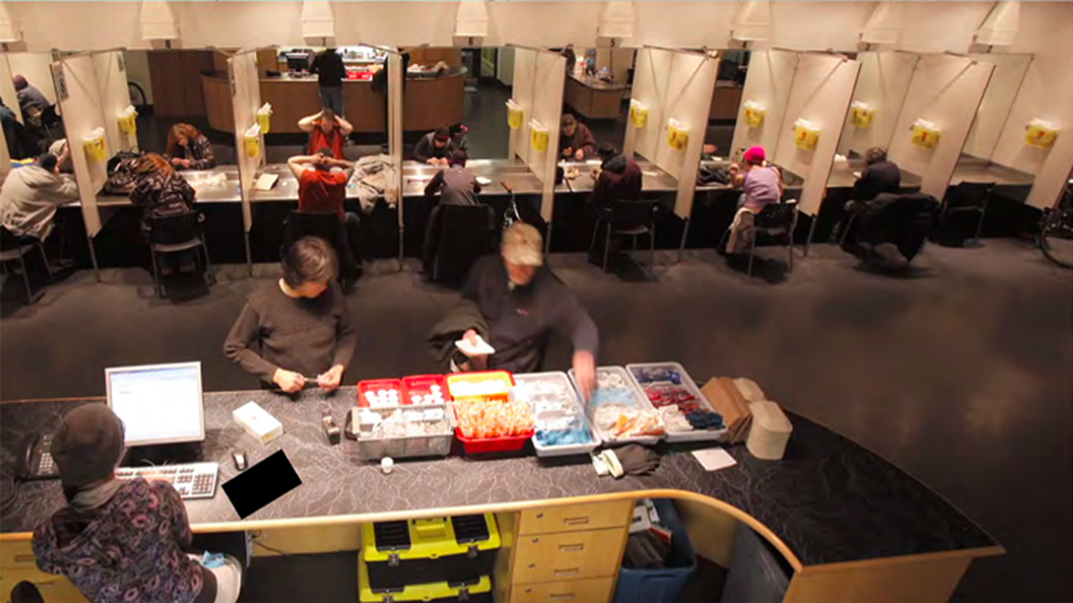
Public Health Outcome #4:
Increase in clients accessing treatment & care
57% accessed treatment from referrals provided at Insite (Petrar et al, 2007)
Even though referrals are common and requested, barriers persist
  20% reported being wait listed and unable to access treatment (Jozaghi & Andresen, 2013)
16% of those referred to treatment in Sydney confirmed participation in treatment (Kimber et al, 2008)
Increases in social service and medical service uptake (McNeil et al, 2014)

Slide 13
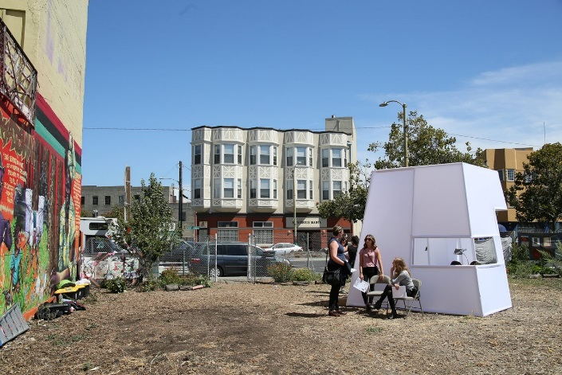

Public Health Outcome #5
A decrease in costs
Insite prevents 35 HIV cases and 3 deaths per year, saving $6 million annually (Andresen & Boyd, 2010)
Another analysis factored decreased needle sharing, increased safer injection behaviors, and increased referrals to MAT – the net savings was $18 million and almost 1,200 life years gained (Bayoumi & Zaric, 2008)
Assuming known outcomes (prevention of HIV/HCV infections, reduced soft tissue infections, reduced OD mortality, and increased treatment uptake), every $1 would save $2.33, saving $3.5 million annually in San Francisco (Irwin et al, 2017)

Slide 14
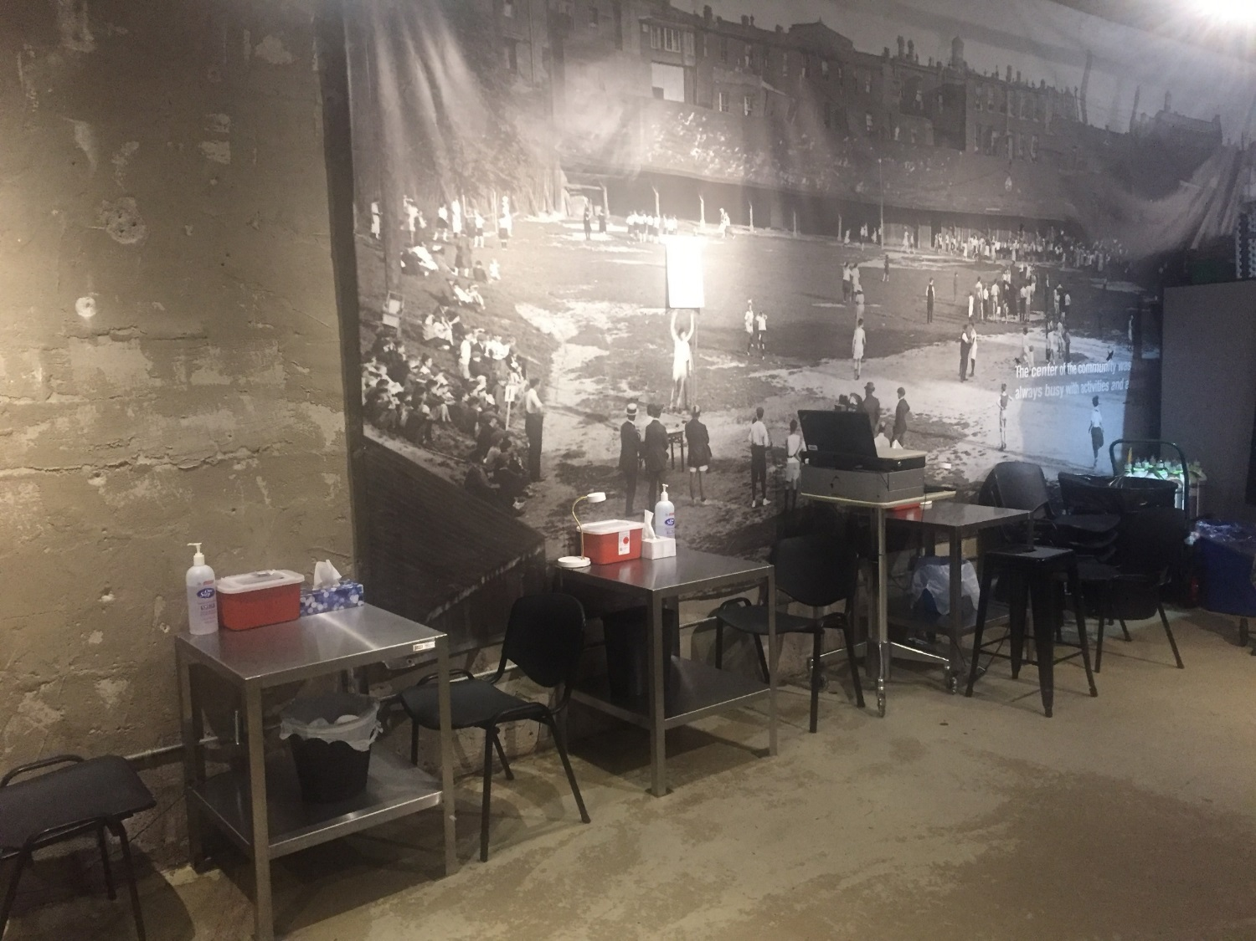
Public Heath Outcome #6:
No increases in the outcomes everyone fears!
No increases in injection rates (Petrar et al, 2007)
No increases in relapse/resuming use (Seeman et al, 2007)
No increases in robbery, drug trafficking, assaults, and noted decrease in vehicle break-ins surrounding Insite (Wood et al, 2006); No increase in drug trafficking in Sydney (Freeman et al, 2005)

Slide 15
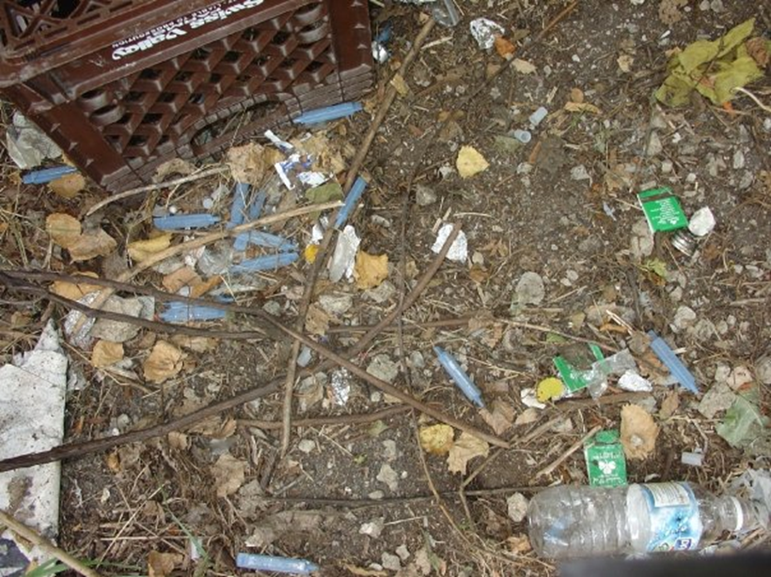
Public Health Outcome #7:
A decrease in discarded paraphernalia
Residents and business owners in Sydney noted a significant decrease in discarded litter
90% of residents noted at least one benefit of SIFs (Salmon et al, 2007)

Slide 16
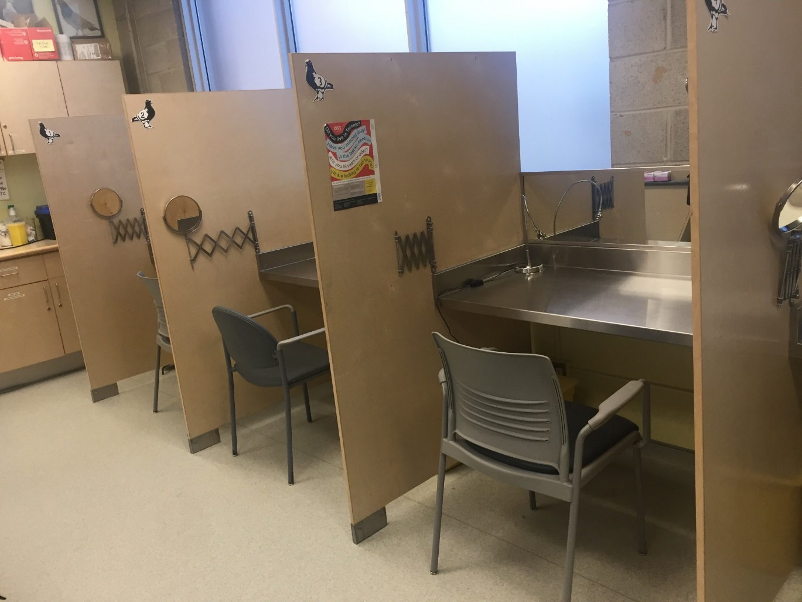
Public Health Outcome #8: SCS is a Safe Haven
Clients prefer injecting at SCS (Wood et al, 2007; Beek et al., 2000)
Clients feel safer in SCS than public or private spaces (Jozaghi et al, 2014; Jozaghi, Reid & Andresent, 2013; Fairbairn et al, 2008; Salmon et al., 2010)
SCS as a “SAFE HAVEN” (Fairbairn et al, 2008; Wood et al, 2007)
All of these outcomes are achieved while serving those at greatest risk of overdose and blood-borne illnesses (Wood et al., 2005)

Slide 17
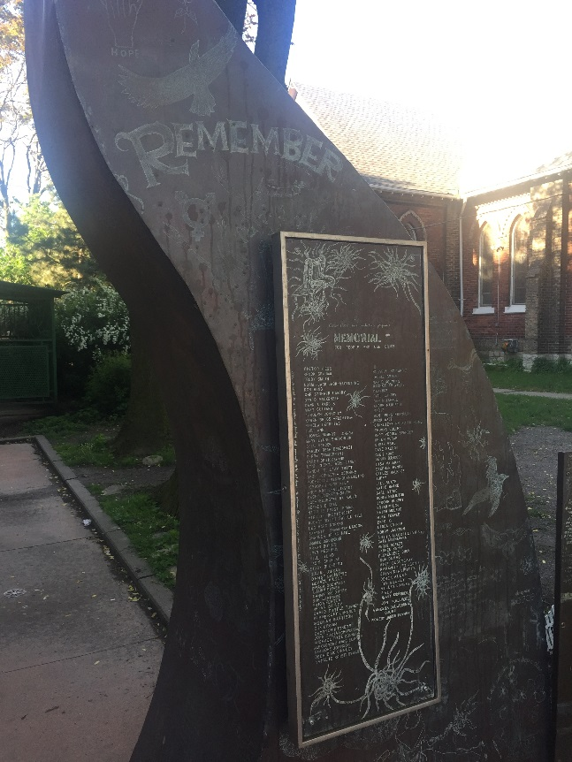
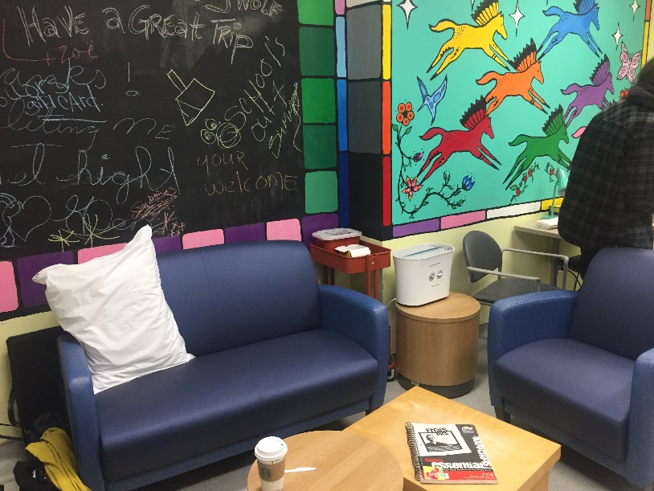
Why?
Safe Space, Respect, Relationships, Trust, Community-Building

Slide 18

Why?
Aligns with Harm Reduction Philosophy and Approach
Motivated by life and health, rather than drug use status
Acknowledges that behavioral health conditions are best addressed with respectful collaboration and evidence-based services NOT systematic isolation and a criminal record
Low-threshold, Participant-driven
Photo by CRA Participant

Slide 19
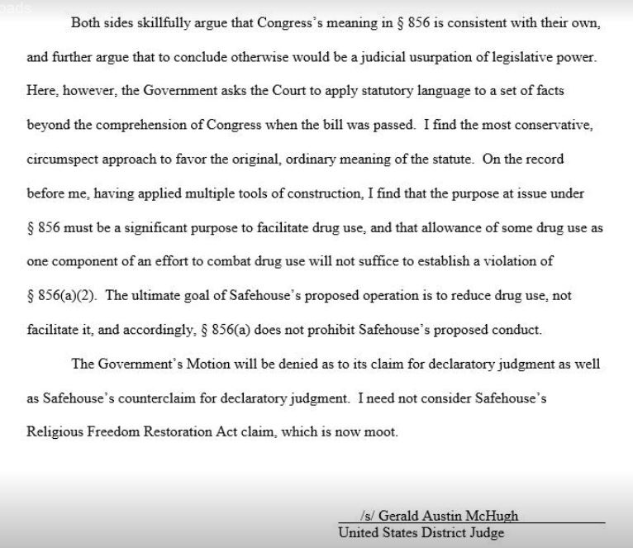
So, how do we make it happen?
Advocacy
Policy Change
Creation of Formal Structures that support the human condition

Slide 20
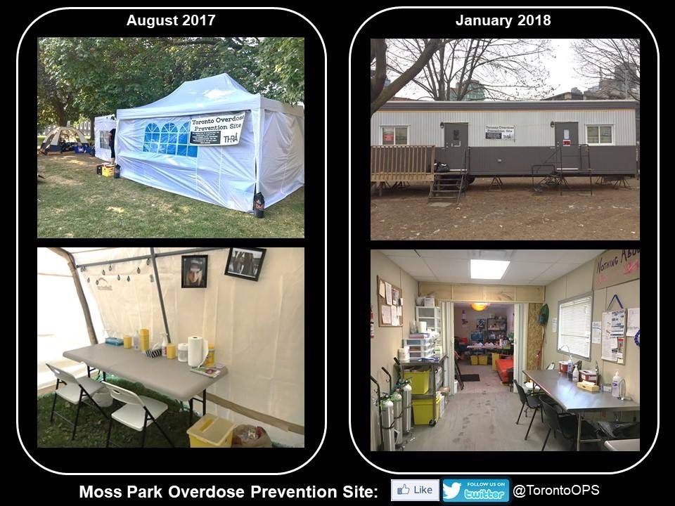
So, how do we make it happen?
Direct Community Action to preserve human life and dignity
Photo Credit: Zoe Dodd

Slide 21
Take Home Message
Current Approach
Preventable deaths
Mass incarceration
SCS
Safer
communities
Better
health
Preservation of life
SCS works to keep people alive, safe, disease-free, and connected to others
As a society, we place significant scrutiny on harm reduction approaches, requiring extensive time and resources from already strapped, chronically- underfunded programs
We need to apply the same scrutiny on the outcomes related to our current policies – The outcomes associated with our punitive approach are vast and devastating!
When you consider the two options, which one is a better choice?
OUTCOMES

Slide 22
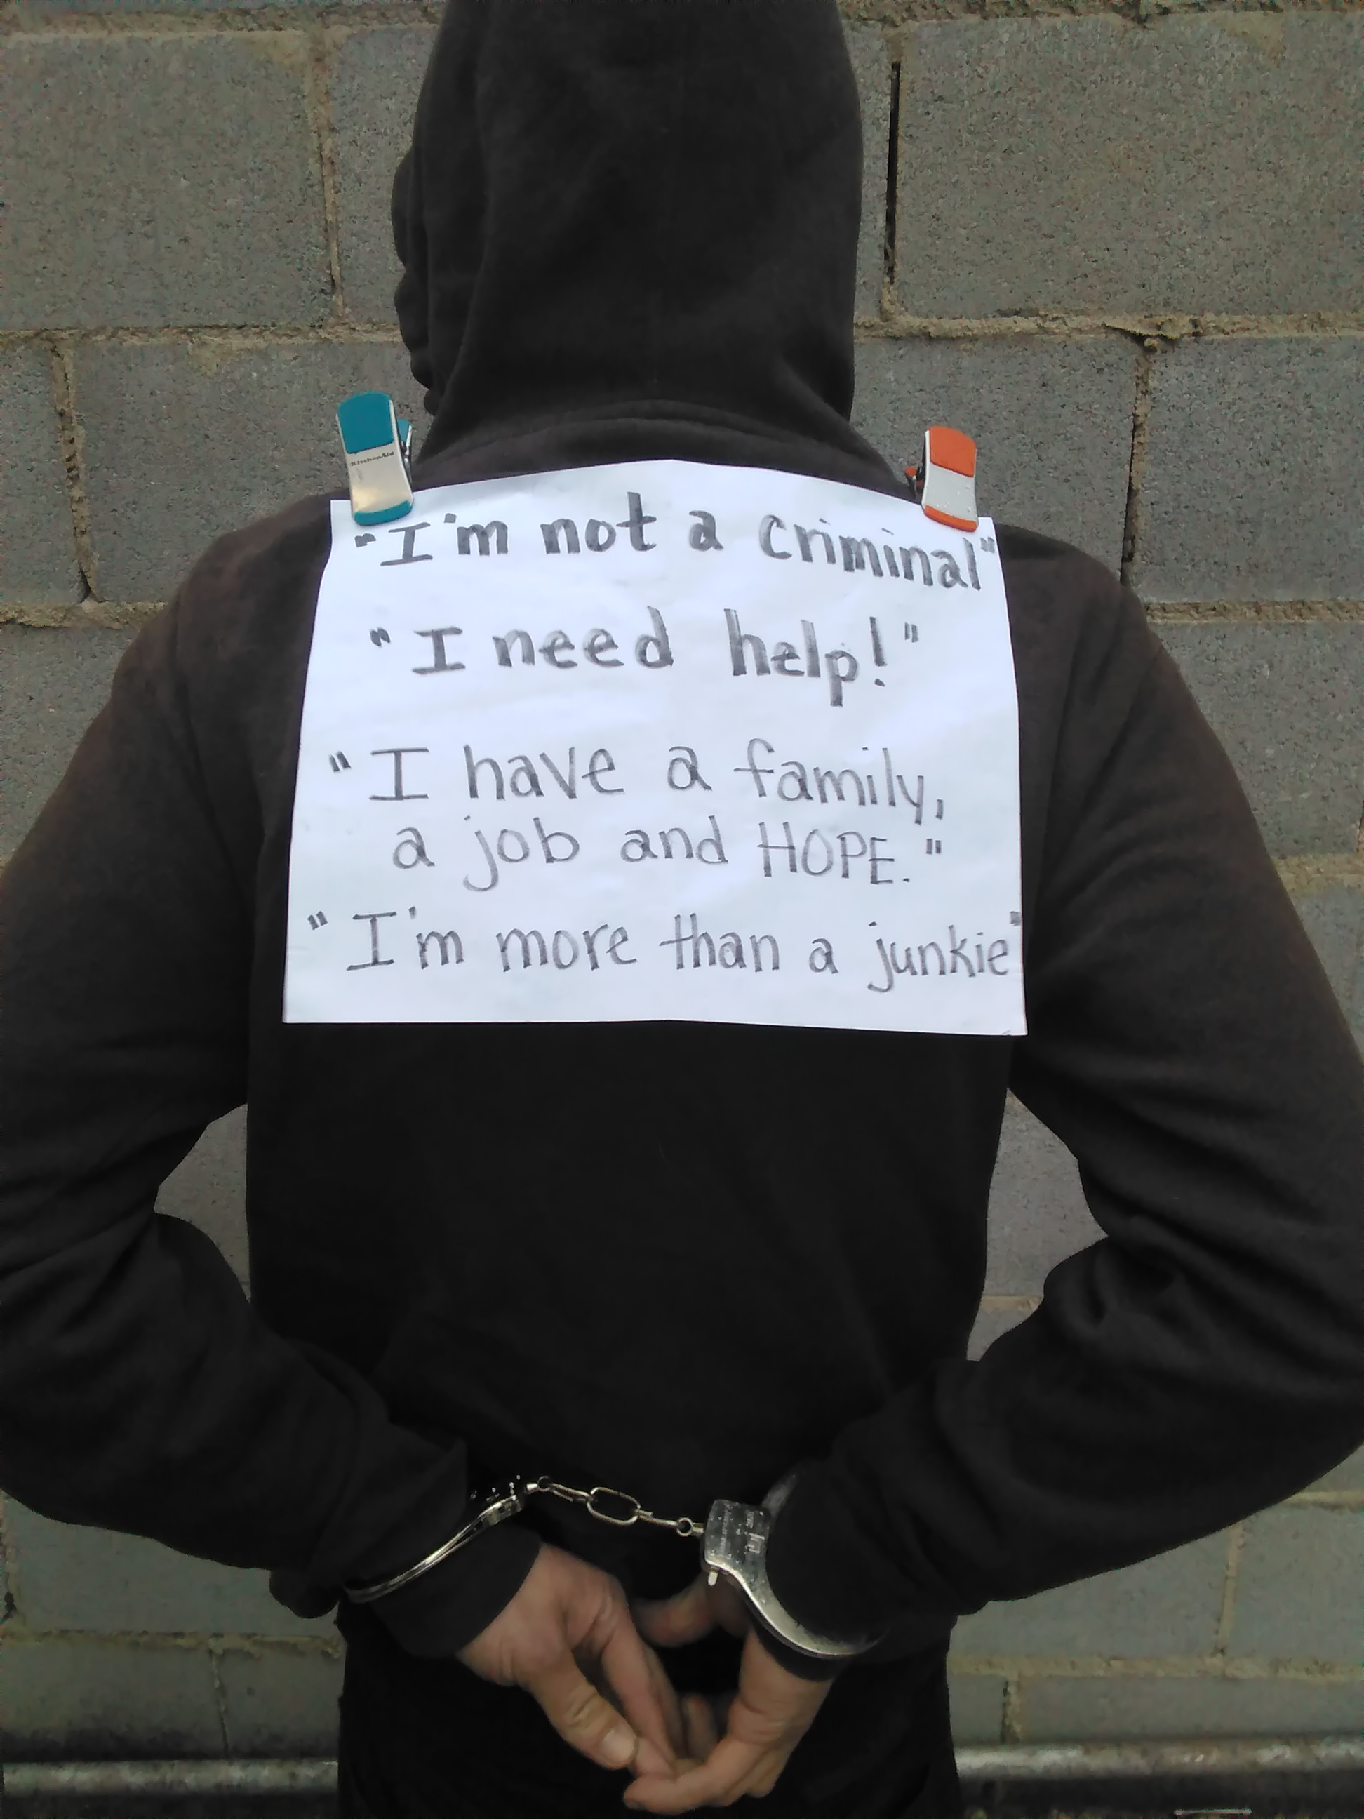
With gratitude for the participants who shared their photos.
Contact me at: scarlber@depaul.edu or Suzanne@anypositivechange.org
Photo by CRA Participant

