Slide 1

Developmental Adversity, Neurobiology, Trauma-Informed Care and Resilience
?

Slide 2

  Adversity, Health and Well-being Across the Life Span
  The Biology of Personal, Social and Historical Experience
  Building Resilience, Healing and Hope

Slide 3
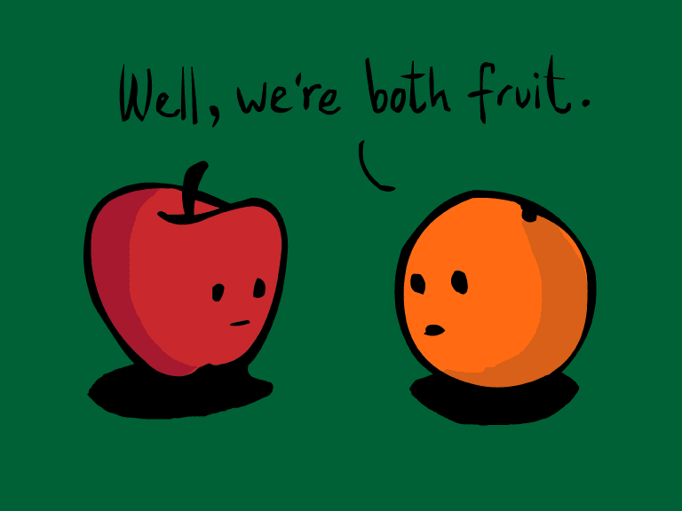
Notes:
As we begin, I’d you to think about this question. What do the following people have in common? : a 45 year old doctor with cancer, an 8 year old who’s having trouble at school, a heroin addict, a politician who lies compulsively, a pro football player who beats his son, and a Native American.

Slide 4
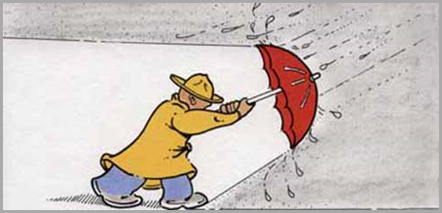

Adversity and Trauma
Adversity-Difficulty, Misfortune
Trauma-Exposure to an Event that:
    Threatens/harms the physical or emotional integrity of an individual or someone close to them
    Overwhelms our ability to respond
    Results in adaptations that create significant difficulty in functioning

Slide 5
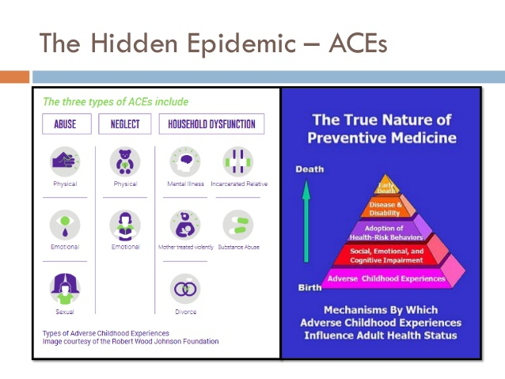
Notes:
Who among you are familiar with the Adverse Childhood Experiences Study? Almost 20 years ago, the landmark Adverse Childhood Experiences Study was published in the American Journal of Preventive Medicine. The largest, and many would argue, most important public health study of its kind to date, the ACE study was co-authored by Dr. Vincent Felitti, an internist from a large health system in California, and Dr. Robert Anda, an epidemiologist from the Centers for Disease Control. In this study, Drs Felitti and Anda surveyed >17,000, mostly white and Hispanic, middle-aged, educated and insured patients about their experiences of 10 categories of abuse, neglect and household distress before they turned 18 and also explored their current physical, mental and social health and well-being. For each category of abuse, neglect or family distress, the participants received 1 point towards and ACE score. What the research team learned was stunning!

Slide 6
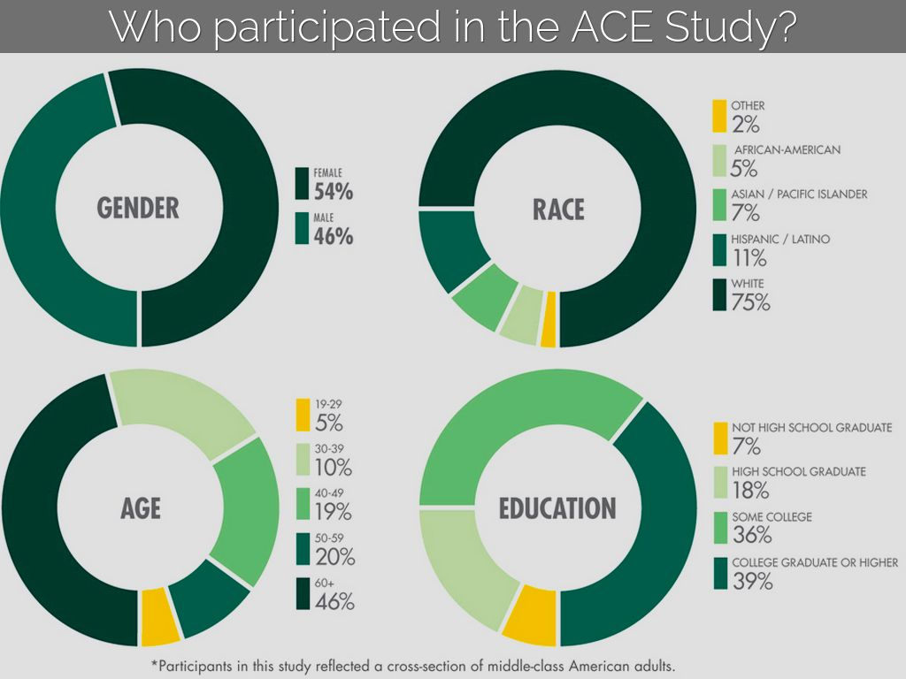

Slide 7
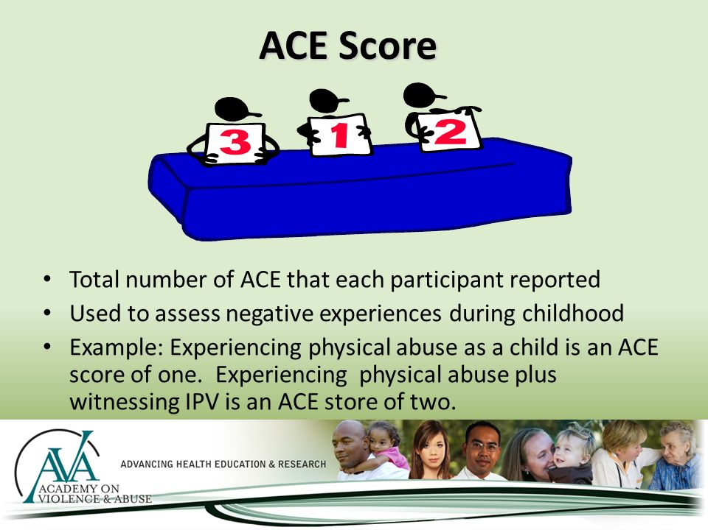

Slide 8
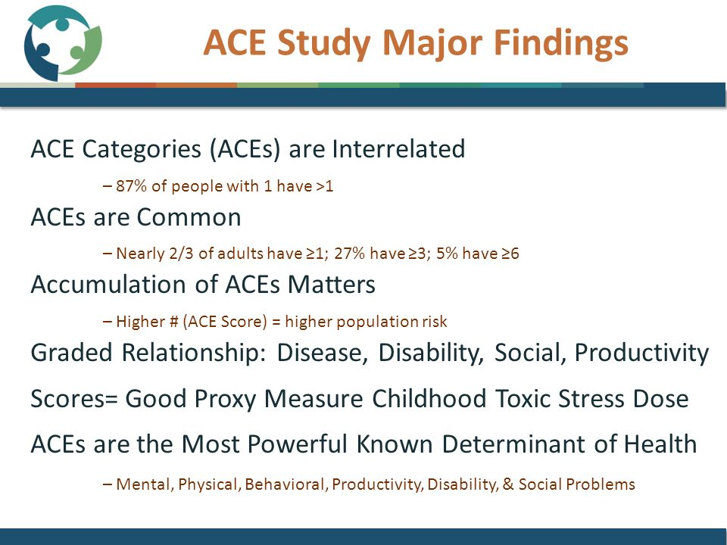

Slide 9
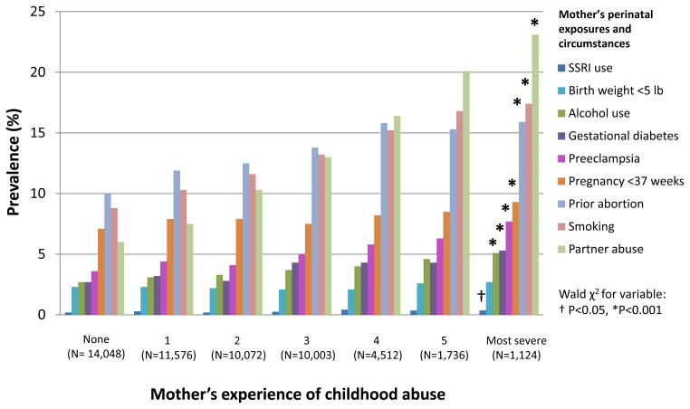

Slide 10
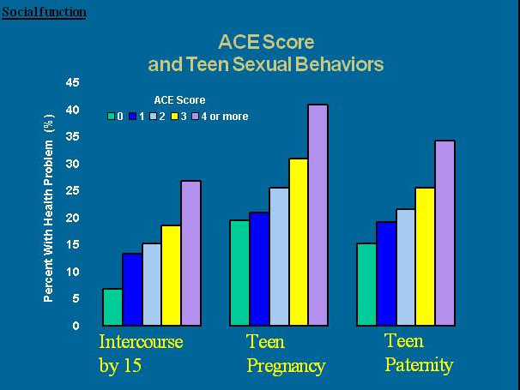

Slide 11
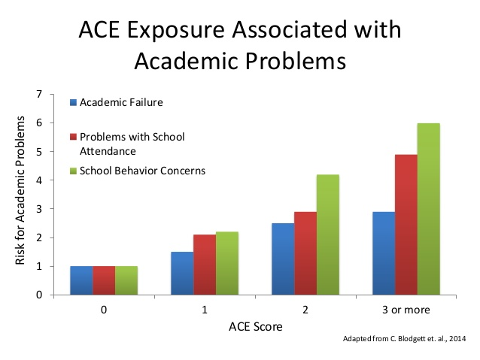

Slide 12
Cumulative ACES & Chronic Disease¹
Prevalence %
¹ Felitti et al., (1998) American Journal of Preventive Medicine, 14:245-258.

Slide 13
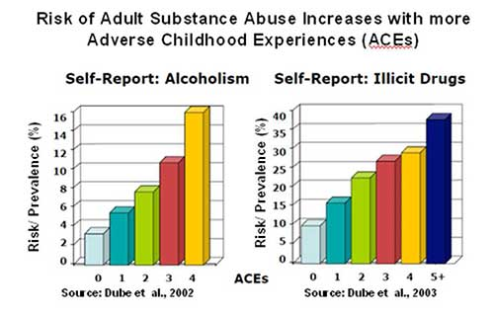
Notes:
We found evidence of a dose-response relationship between ACEs and alcohol use during pregnancy that remained even after controlling for pre-pregnancy drinking and other covariates.

Slide 14
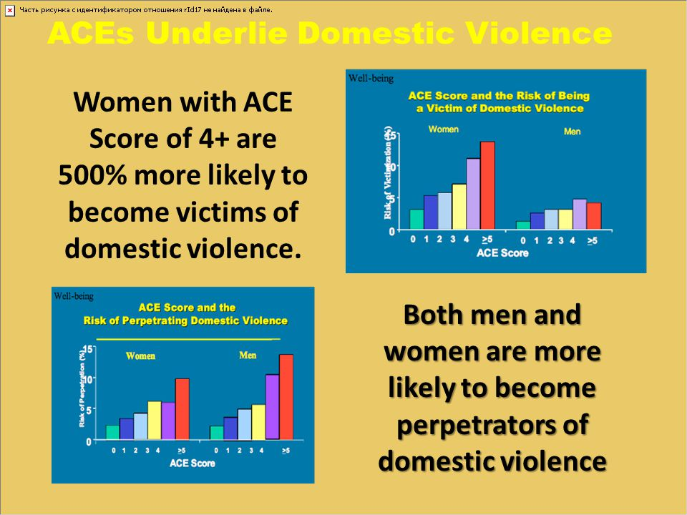

Slide 15
Cumulative ACES & Mental Health
Prevalence %
Data from the National Comorbidity Survey-Replication Sample (NCS-R) - Putnam, Harris, Putnam, J Traumatic Stress, 26:435-442, 2013

Slide 17
Cumulative ACES & Impaired Worker Performance¹
Percent % Reported
¹ Anda et al., (2004) The Permanente Journal/Winter 8:30-38.

Slide 18
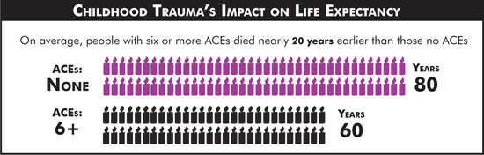

Slide 19
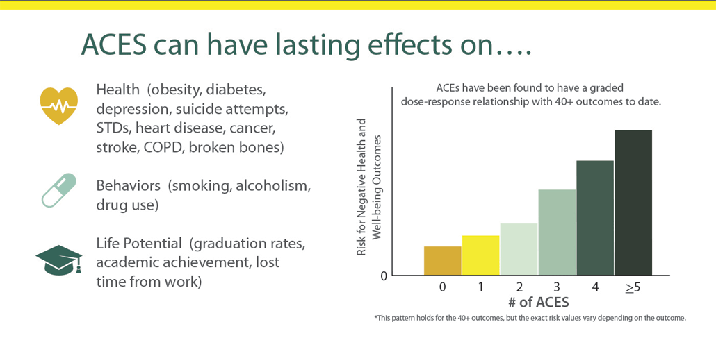

Slide 20
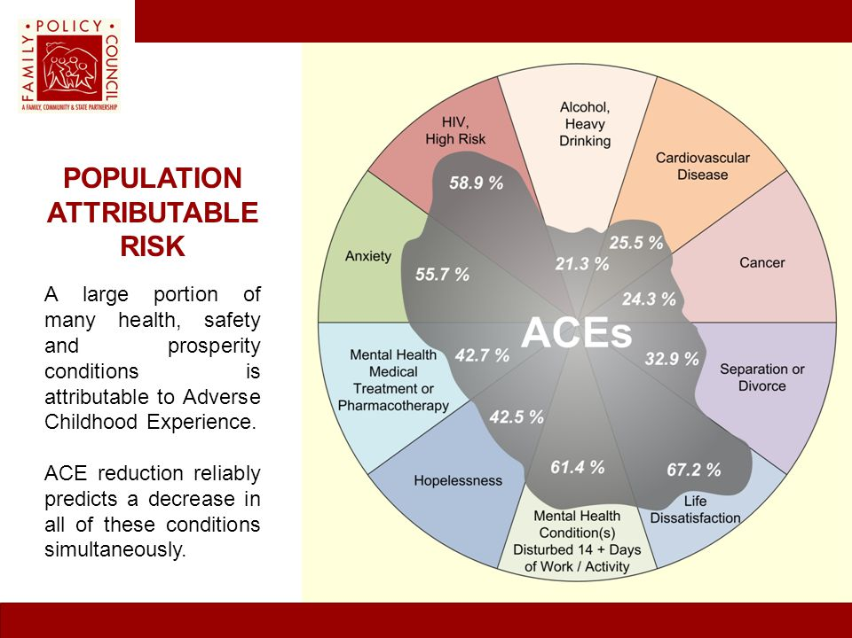

Slide 21
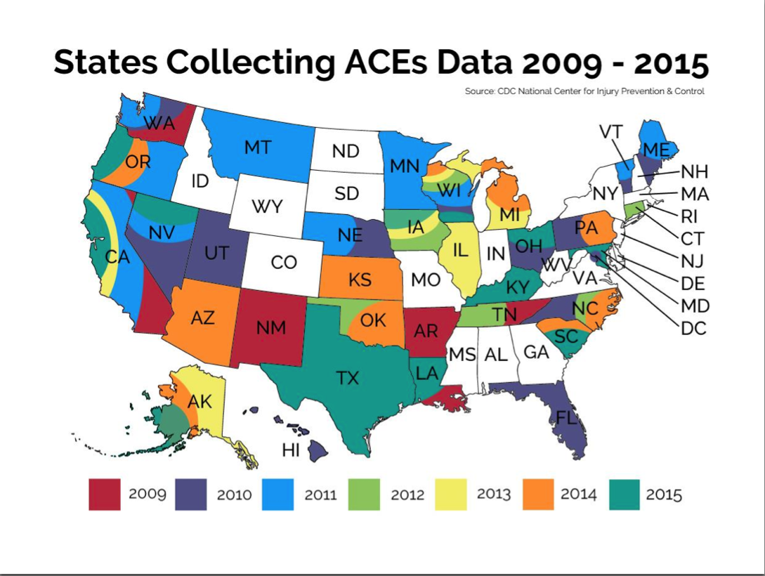
Notes:
So you might be thinking, “Audrey, that is really interesting, but what does a study about a bunch of white people in California have to do with us?”
It turns out that not only was the ACE study done in California, but it has been replicated in more diverse populations with similar results in 32 states and 31 countries internationally. In 2012 through the National Survey of Children’s Health we learned that 32% of Illinois children had at least 1 experience of adversity and through the Behavioral Risk Factor Surveillance Survey ( a public health phone survey), in 2013, we learned that 60% of Illinois adults reported at least 1 ACE. From the Chicago Longitudinal Study, we know that of 1200 lower income, minority youth who were followed for 2 decades, nearly 2/3 had an ACE score >=1. Those with ACE score>=4 had reduced high school graduation rates, higher risk of depression and health-compromising behaviors, and juvenile arrests and felony charges as well as less likelihood of holding a skilled job or going further in school.
Based on data from all of these studies, ACEs are the most powerful known determinant of Health.

Slide 22
Subsequent ACEs Work
In 2009, 85% of a homeless population reported at least 1 ACE, 55% reported 4 or more
In 2013 BRFSS,60% of adult Illinois residents and in NCHS, 40% of children Birth-17 had at least 1 ACE
In 2014, Juvenile offenders in Florida had an average composite ACE score of 3.5-4.3

Slide 23
Chicago Longitudinal Study
1202 low income, minority participants born 1979-80
2/3 had experienced>=1 ACE by age 18
After controlling for demographic factors and early intervention >=4 ACE had poorer outcomes
  Decreased high school graduation
  Increased risk of depression and health compromising behaviors
  Juvenile arrest and felony charges
  Less likely to hold skilled jobs

Slide 24
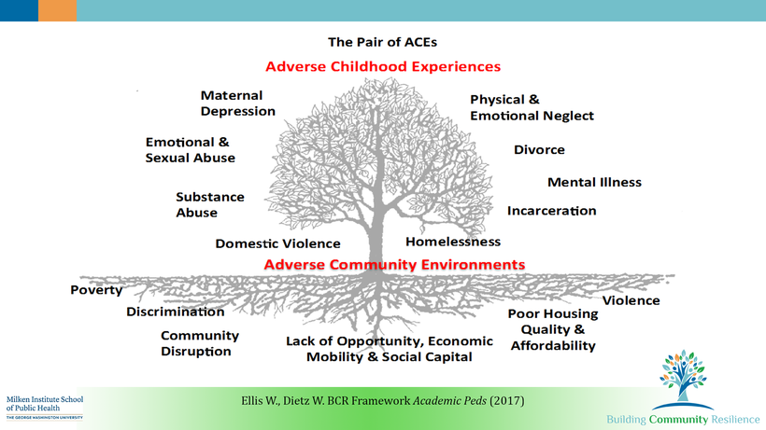
The ACE Scale can be Improved by Adding Additional Adversities
Improving the ACE Scale by Acknowledging Additional Adversities
Notes:
In 2014, Dr. Roy Wade and colleagues from Philadelphia developed an expanded ACE questionnaire to assess the prevalence and impact of additional experiences, which include family relationships, community stressors, personal victimization, economic hardship, peer relationships, and discrimination, as well as school, health, and child welfare/juvenile justice systems issue, all of which are also critical factors in health and well-being. Current research demonstrates the negative impact of these and other Adverse Community Events on the brain, physiology and behavior.
Keeping the recent research about holocaust survivors in mind, another critical layer of adverse experience which we must consider and which is not yet depicted here is the trauma of previous generations such as slavery, holocaust, and cultural genocide .

Slide 25

Notes:
From the ACE study it is clear that experiences change the body, but how do we discover the pathway, and how does this influence our approach in medicine, education, social services or business?

Slide 26
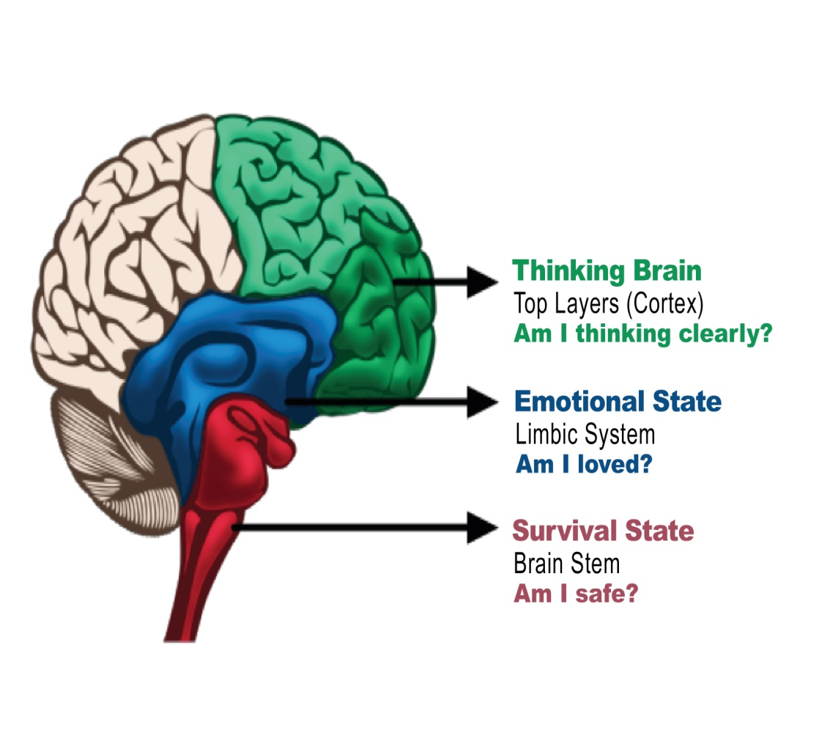

Neurodevelopment and Attachment
Notes:
Around the same time period as the collection of the ACE Study data, there was an explosion of sophisticated neuroscience research from 1990-1999 , the Decade of the Brain .
We’re going to do a crash course in normal neurodevelopment and attachment to better understand how experience can cause disease, disability and death. For the sake of simplicity, our brain is composed of three parts, the brainstem or survival brain, the midbrain or emotional brain, and the cortex or thinking brain. Our brain develops in response to our experiences and our environment from the bottom up from the survival brain to the cortex, starting prenatally and continuing until about age 24. This responsiveness of the brain is called neuroplasticity. Also important to note is that there are critical and sensitive periods for development. For example, if we remain in a dark room during the critical period for development of vision, we will be blind.
Attachment is the special emotional relationship that involves an exchange of comfort, care, and pleasure. Early attachment styles are established in childhood through the infant/caregiver relationship. Attunement is the perception and understanding of the wants and needs of others.
Stress and trauma can disrupt attachment, derail the optimal growth and development of the brain and autonomic nervous system, its signaling to all of the other body systems, and our overall physiology . Secure attachments and attunement protect and heal from later stress, distress and trauma.

Slide 27
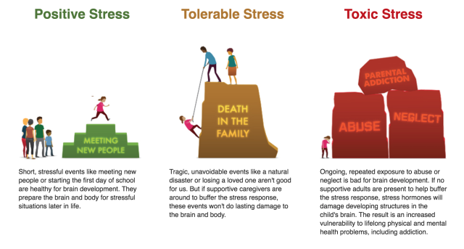
Notes:
Stress is pressure or tension exerted on a material object.

Slide 28
Stress
Positive or Tolerable
Toxic
Predictable
Moderate
Controlled
Resilience
Unpredictable
Severe
Uncontrolled
Vulnerability

Slide 29
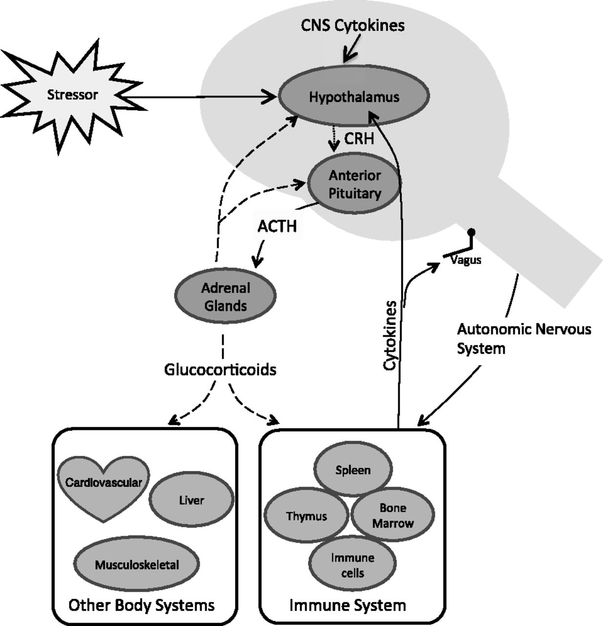
The Impact of Stress on Physiology
Notes:
Allostatic load is "the wear and tear on the body" that accumulates as an individual is exposed to repeated or chronic stress.^{[1]} It represents the physiological consequences of chronic exposure to fluctuating or heightened neural or neuroendocrine response that results from repeated or chronic stress.^{[2]} The term was coined by McEwen and Stellar in 1993

Slide 30
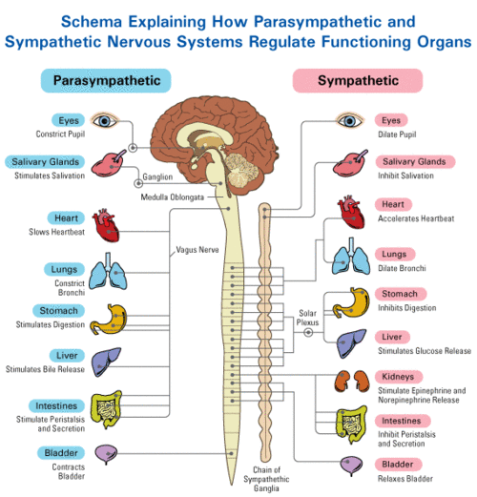
Brain Regulates Body through
Autonomic Nervous System
Thoughts or
reactions to memories
(am I safe?
am I loved?)
are transmitted
from brain to body
in less than a second

Slide 31
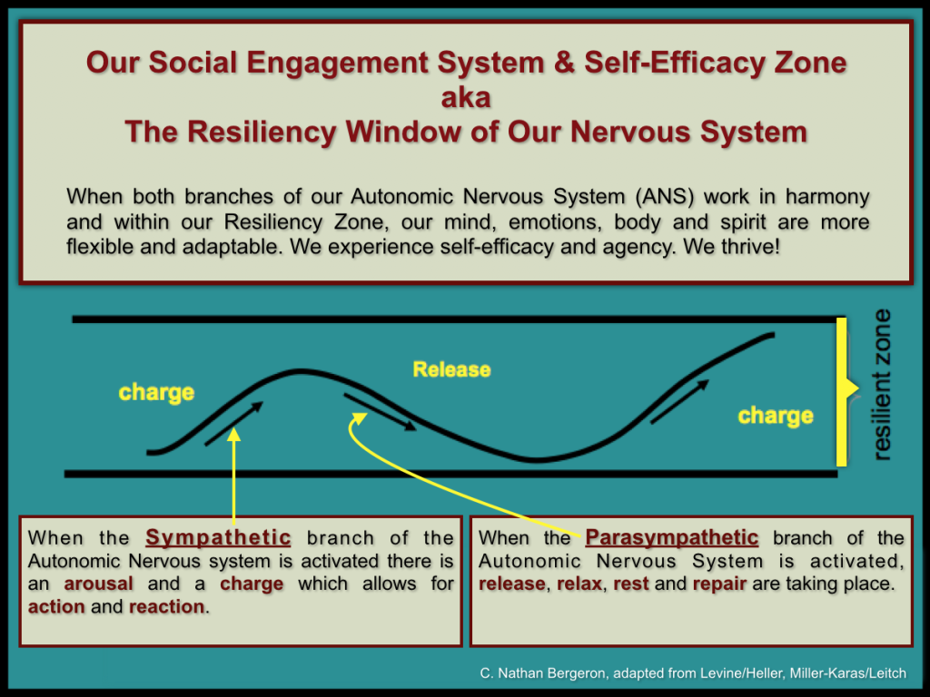

Slide 32
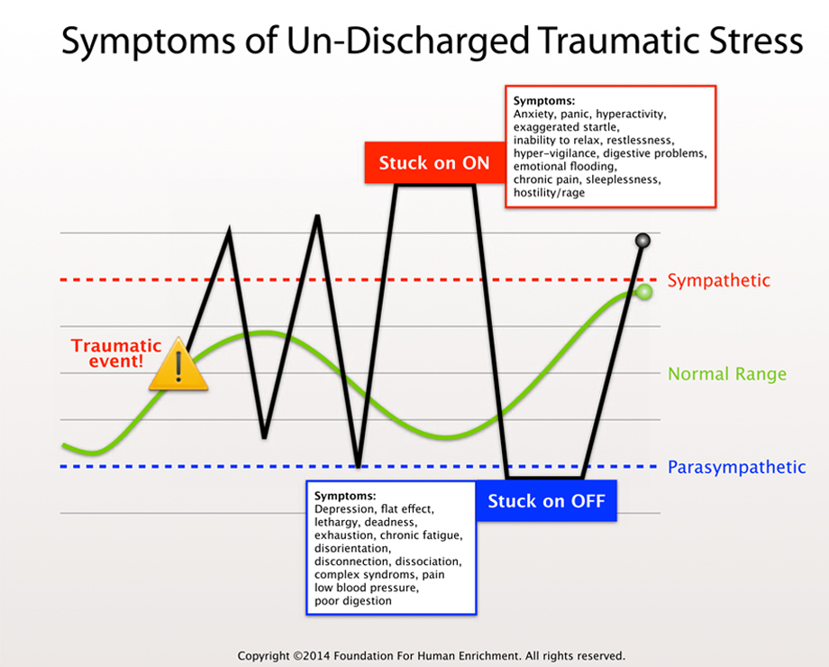

Slide 33
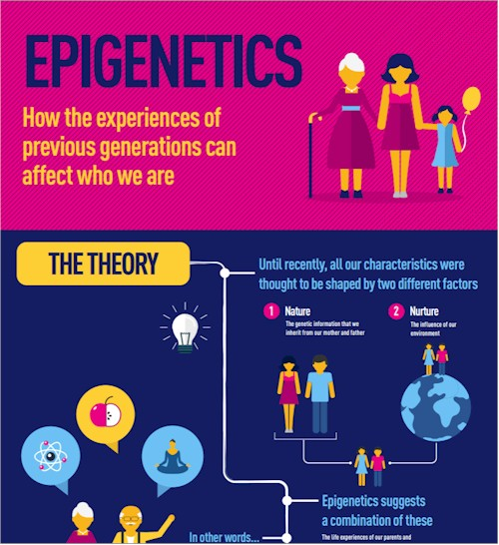
Notes:
What role do our genes play in growth and development vs our experiences? Our genes are in a dynamic relationship with the environment. Our experiences affect markers, or epigenes, which turn our genes on or off, making us healthier or sicker. These genetic modifications can be passed from one generation to the next as nature’s way of preparing the next generation for the environment it will face. Recent studies on children of holocaust survivors reveal that they have inherited genetic changes related to their parents’ response to trauma.

Slide 34
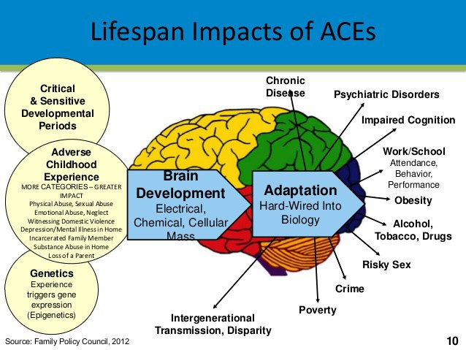
Notes:
In summary, genes, epigenes and experiences, their timing, severity and chronicity, shape the development of our brains and physiology and lead to adaptations that can become hard-wired in our biology in this generation and subsequent generatoions. These adaptations become embodied and lead to disease, school problems, health-compromising behaviors, crime, poverty, disparity, and early death.
Let’s return to the question we started with, what do the apples have in common with the oranges? That is, what does a cancer patient have in common with a drug addict, or a child abuser, or a Native American? Sadly, the answer is their history of trauma.

Slide 35
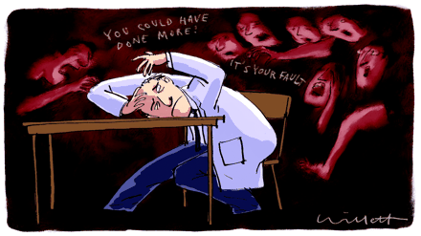
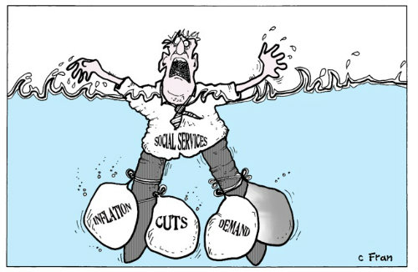
Secondary Trauma
Notes:
Secondary Trauma--The negative changes over time as direct service providers (DSP) witness other people’s suffering and need which over time can lead to changes in psychological, physical, and spiritual well-being.
DSP have their own ACE history
Budget issues, insufficient resources for ourselves and our clients, and general unpredictability harm our morale and well-being

Slide 36
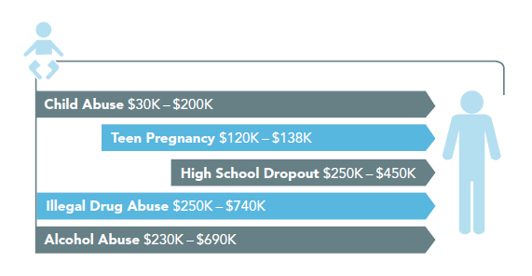
What does it cost to do nothing?
Each 2014 First-Time Case of Child Maltreatment Costs U.S. Economy
Approximately $1.8 Million in Total Expenditures over their Lifetime¹
$1.8 Million per 2014 victim¹
Graphic from Pew Issue Brief Jan 2011: Paying Later: High Cost of failing to Invest in Young children.
¹Suffer the Little Children: An Assessment of the Economic Costs of Child Maltreatment
The Perryman Group, info@perrymangroup.com

Slide 37


Slide 38


Neuroplasticity and Resilience
Notes:
Deep breath….The good news is that we’ve got a lot going for us. We can harness both the phenomenon of neuroplasticity, our brain’s ability to reorganize itself, physically and functionally, over our whole lifetime, and the concept of resilience, our ability to bounce back, to design strategies for healing and transformation. We are born with neuroplasticity and we are able to develop resilience. Resilience is built through positive social conditions, through attunement, and through secure attachment relationships.

Slide 39
Building Resilience from the Bottom Up
Reason
Relate
Regulate

Slide 40
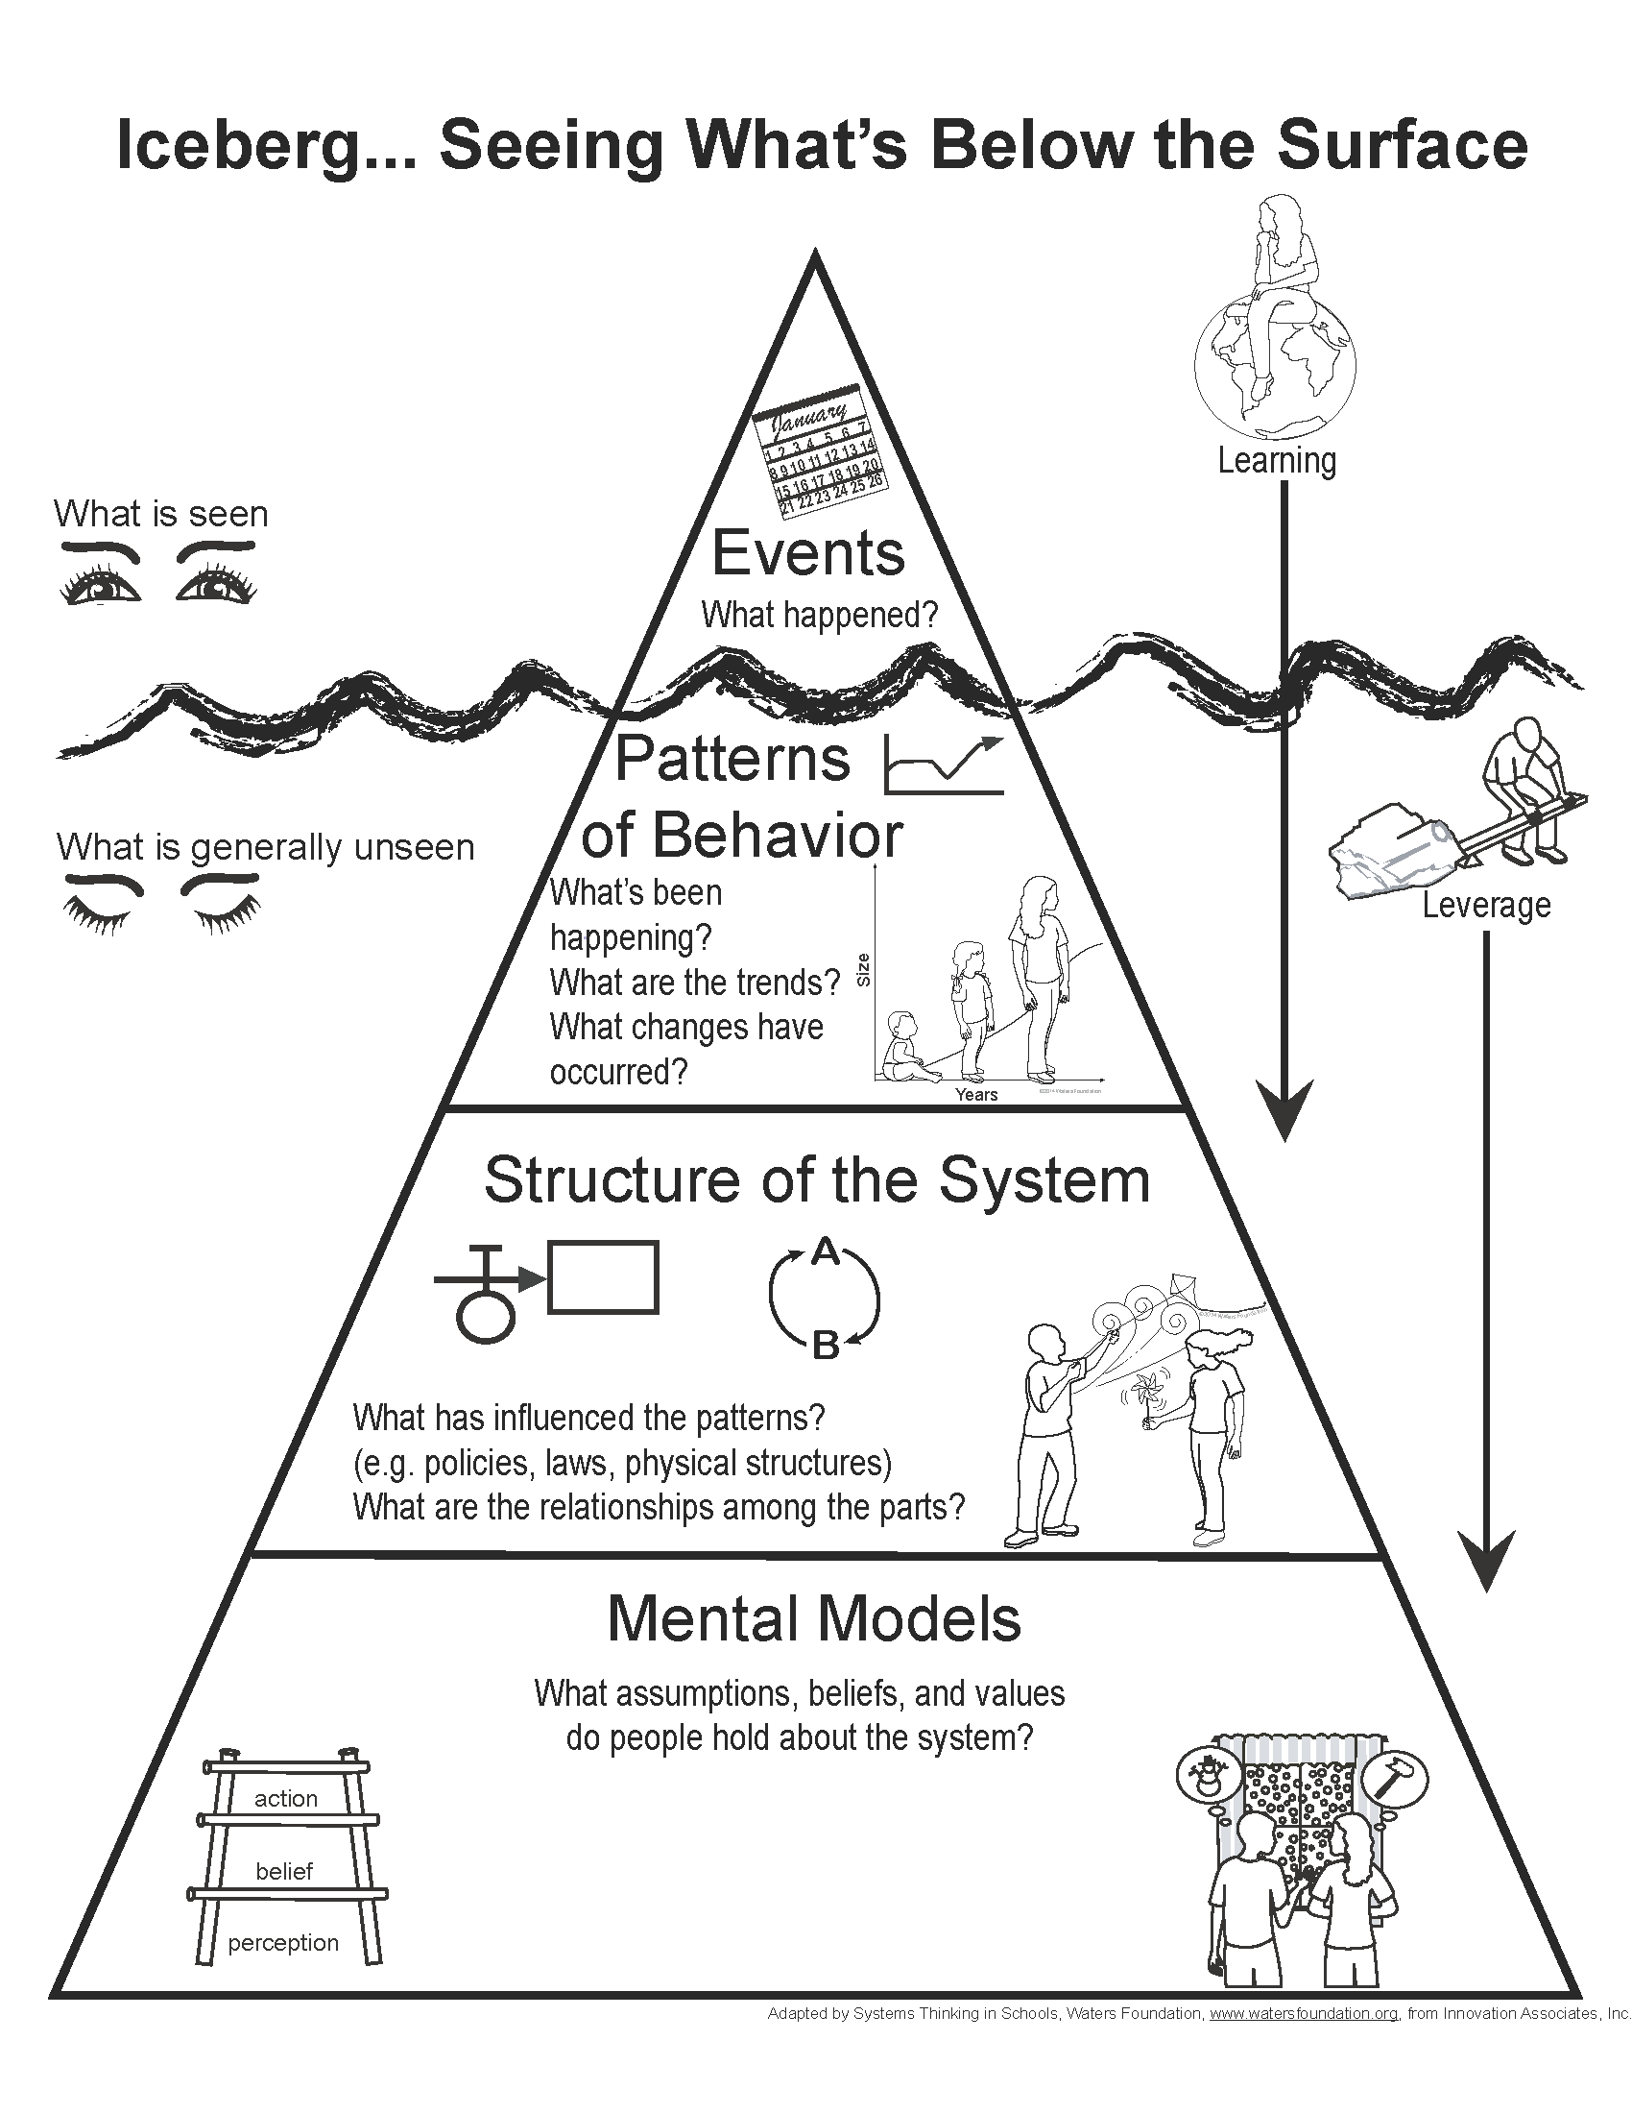
1. Change Our Minds for Systems Change
Notes:
Not “what’s wrong with you” but “what happened to you”
Symptoms are adaptations
Violence causes trauma and… trauma causes violence
Trauma results from disrupted relationships
Relationship is the vehicle for life success
Attachment is the key to well-being

Slide 41
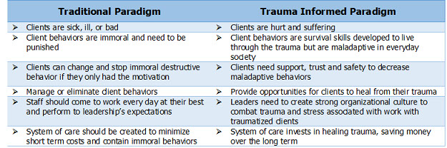

Slide 42
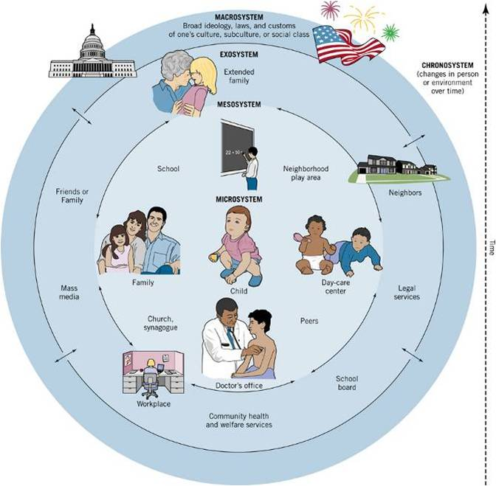
Notes:
In order to take advantage of neuroplasticity and resilience, we need to embed strategies for healing and transformation throughout our human ecology from the individual and family levels, to our communities and ultimately to our cultures over time. These strategies include self-and co-regulation, strengthening individual knowledge, skills and relationships, raising community awareness, educating service providers, fostering coalitions and networks, changing organizational practices and influencing policy, legislation and high impact conversations.

Slide 43
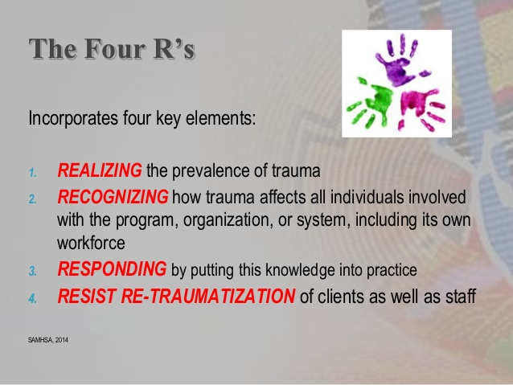
ACEs and the Next Generation
SAMHSA’s Concept of a Trauma-Informed Approach
ACEs and the Next Generation

Slide 44
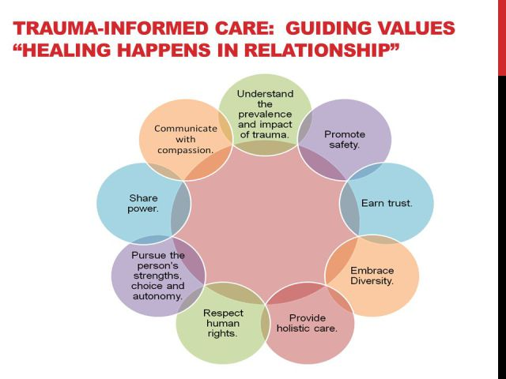

Slide 45
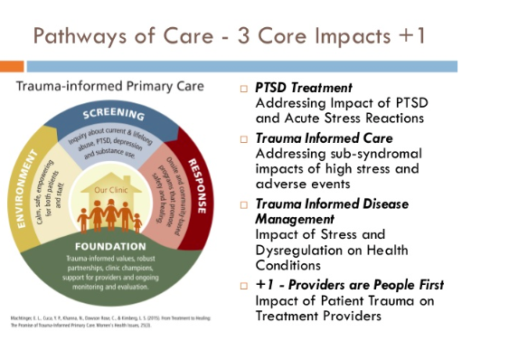

Slide 46
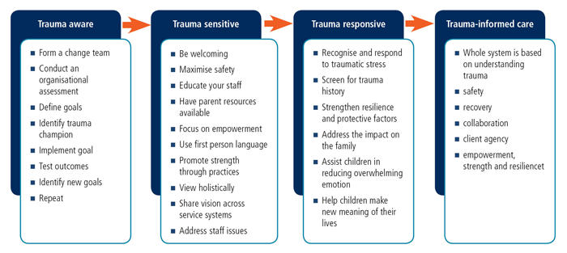
The Path to Becoming a Trauma Informed Organization

Slide 47
Trauma-Informed Organizations
Trauma Aware | Trauma Sensitive | Trauma Responsive | Trauma Informed
Do most staff understand the term ‘trauma’? Are they aware that this knowledge can change they way they view and interact with others? • Is information about ACEs and trauma referenced in informal conversations? • Is workplace safety a priority and does your organization consider both physical and mental health? | Does your organization value a trauma-informed lens and identify trauma and resilience in your policies? • Is trauma training institutionalized for all staff? • Is basic information about ACEs and trauma made visually available to staff? • Does your staff feel supported and understood in the workplace? • Does your organization promote a culture of democratic decisionmaking? • Does management recognize compassion fatigue and vicarious trauma? | Does staff apply knowledge of trauma and resilience to specific work? Does your staff utilize language that supports safety, choice, collaboration, trustworthiness, and empowerment? Do policies support addressing vicarious trauma among staff? Does your organization promote a culture of democratic decision making and shared responsibility in problem solving and conflict resolution? Does your organization utilize a “universal precautions” approach in which everyone is screened for ACEs and/or trauma? Are people with lived experience encouraged to take meaningful roles in institutional change? Have changes been made to the physical environment to reflect trauma-informed policies? Are trauma-specific assessment and treatment models available for those who need them? | Is your entire staff skilled in using trauma-informed practices? Does everyone involved in the organization feel that they are a part of the decision-making process? Do individuals outside of your organization understand that trauma and resilience are at the center of your mission? Is your organization viewed as a leader in trauma-informed practice? Does your organization use data to drive decisions at every level? • Are a variety of sustainable trainings including ongoing coaching and consultation made available to staff? Does your organization’s business model and fiscal structure consider the need to address trauma?

Slide 48
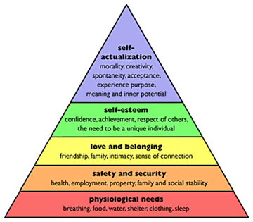
Insuring The Basics
Notes:
We can start with Maslow’s hierarchy of needs and commit to the social welfare of all people by creating conditions that adequately meet physiologic needs as well as needs for safety and security, and love and belonging, in order to establish the optimal conditions for everyone to find purpose and meaning, to fulfill their own potential and to develop the capacity to raise the next generation.
In order to reduce prematurity and low birth weight. Dr. Colleen Kraft of Cincinnati Children’s Hospital used Medicaid dollars to augment the Patient Centered Medical Home to create a Family Centered Medical Home to address all physical and emotional needs of pregnant women, including housing, food, education, transportation and legal assistance. This program eliminated prematurity and low birth weight.

Slide 49
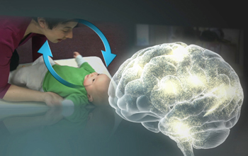


Part 2: From the Beginning to the End
Neurodevelopment, Attachment, and Attunement

Slide 50

To Screen or Not To Screen
Notes:
F/u to the original Study—Compassionate listening to the answers to “How have these experiences affected you in adult life?” yielded major reductions in office visits, ER visits, Hospitalizations and prescription drug use.
In the context of primary care, screening parents about ACE and social needs is accepted and can offer a new way of looking at things and a motivation for change.
Dark side of screening—retriggering? Can we handle it? Do we have sufficient referral resources?
In the relationship.
How was/is growing up for you?
An effective strategy with youth is teaching about brain development and strategies for building resilience.

Slide 51
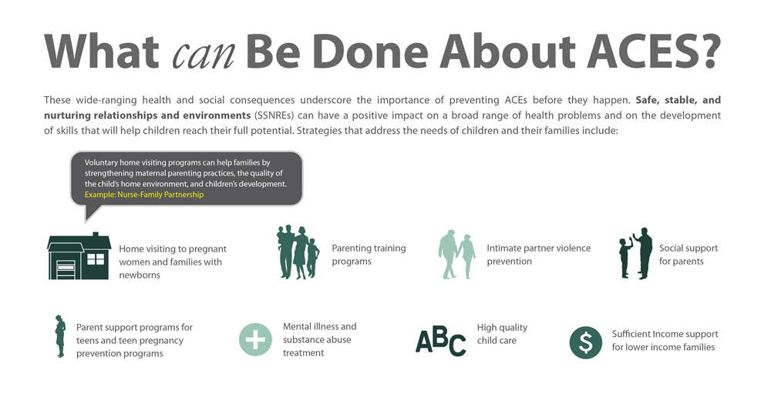
Notes:
NFP results: decrease in abuse and injury and improvement in cognitive and socioemotional outcomes in children as well as reduction in mothers’ subsequent births during their late teens and early twenties and reduction in prenatal smoking among mothers who smoked at the start of the evaluation. Mercy, J. A., & Saul, J. (2009). Creating a healthier future through early interventions for children. JAMA, 301(21), 2262-2264.
Triple P: lower rates of child abuse, reduced foster care placements and decreased hospitalizations from child abuse injuries, improved parenting skills, well-being, and confidence as well as decreased parental stress and depression.
The University of Queensland. Parenting and Family Support Centre. Retrieved from www.pfsc.uq.edu.au/research/evidence

Slide 52

For Individual Healing,
Support the Mind Body Connection

Slide 53
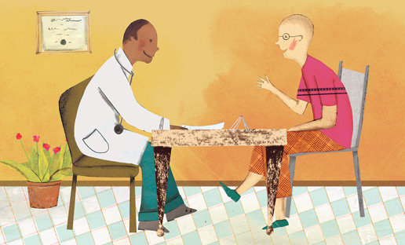



Radical Acceptance, Self-Regulation, Creative Self-Expression and Rhythm
Evidence-Based Solutions for Trauma Recovery
Notes:
Open-ended questioning with Compassionate listening—repairs attachment, establishes safety
Meditation—increases self-awareness and interoception, settles the ANS
Journaling-Helps create a coherent narrative through integration of the right and left hemisphere—meaning making improves health. Expressing anger through writing improved control over pain, pain severity and depressed mood
Rhythm helps reset and quiet the brainstem

Slide 54
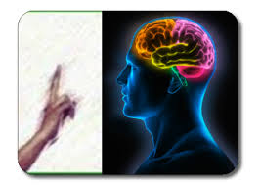


Trauma Specific Treatment for Neuromodulation
Notes:
The strongest rationale for considering neuromodulatory approaches as treatments for chronic pain is the growing understanding that all pain is ultimately the result of supraspinal cortical processing;12 that is, our experience of pain results from what the brain does with sensory input, rather than from the sensory input itself.
Neurofeedback modifies brain processes by decreasing activity related to nociceptive process and increasing activity related to increased relaxation and pain diminishment
EMDR Reduces Pain Intensity and Disability and increases pain-coping and relaxation We propose that the repetitive redirecting of attention in EMDR induces a neurobiological state, similar to that of REM sleep, which is optimally configured to support the cortical integration of traumatic memories into general semantic networks. We suggest that this integration can then lead to a reduction in the strength of hippocampally mediated episodic memories of the traumatic event as well as the memories' associated, amygdala-dependent, negative affect.
Hypnosis hypnotic treatments reduce pain intensity effectively, and do so for a wide variety of pain problems. found that hypnosis and meditation have similar neurophysiological profiles. Left brain quiet and right brain receptive to suggestion.

Slide 55
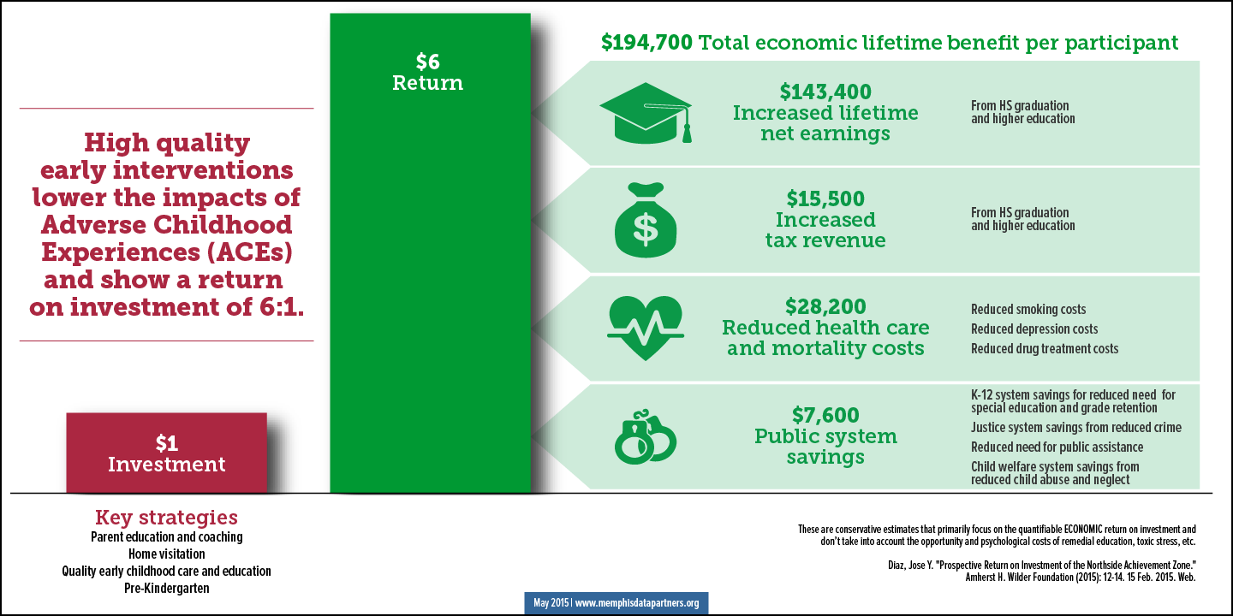
Prevention & Treatment Save Money (and Lives)!
Silver Lining—Resilience Trumps ACEs

Slide 56

ACE and trauma (Individual, Community, Structural and/or Historical) are powerful known determinants of health.
ACE/Trauma in the absence of protective factors cause neuroinflammation, derailment of normal physiology, and become embodied leading to illness.
Healing practices, which create safety, meet basic needs, support self-regulation, and build relationships, can prevent and treat the consequences of ACE and Trauma
Notes:
Our current and historical experiences as individuals, in families, in communities and as a society shape who we are because they affect our biology and chart the course of our growth and development. Humane social conditions and secure and attached relationships which build resilience allow us to weather life’s storms.
We have the knowledge and power to prevent, mitigate, and treat the root causes of our deepest suffering so that we can identify our true purpose and fulfill our potential. Our lives and the lives of the next 7 generations are at stake and depend on our taking action now. Transformation is possible. Transformation is imperative. Let’s Do It!

Slide 57
Questions
Audrey Stillerman MD ABFM ABIHM ABOIM
UIH Office of Community Engagement
Center for the Collaborative Study of
Trauma, Health Equity and Neurobiology
ajstille@uic.edu
312-996-4656

Slide 58
https://www.youtube.com/watch?v=ccKFkcfXx-c
https://www.youtube.com/watch?v=LmVWOe1ky8s

