Slide 1
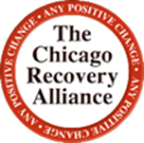
Reframing the Rhetoric: Using evidence in reporting about substance use
Suzanne Carlberg-Racich, MSPH, PHD
Board Member, Health & Medicine Policy Research Group
Assistant Professor of Public Health, DePaul University
Director of Research, Chicago Recovery Alliance

Slide 2
Opioid Overdose Deaths, 2015 and 2016
The death rate from opioid overdose increased 74% in one year in Chicago.
Age-adjusted death rate per 100,000
Slide courtesy of Dr. Elizabeth Salisbury-Afshar, American Institutes for Research
Seth P, et al. Overdose Deaths Involving Opioids, Cocaine and Psychostimulants- US 2015-2016. MMWR March 30, 2018.
Epidemiology Report: Increase in Overdose Deaths Involving Opioids, Chicago 2015-2016

Slide 3
Opioid-Related Overdose Deaths by Drug Type in Chicago, 2015 and 2016
Age-adjusted death rate per 100,000
Slide courtesy of Dr. Elizabeth Salisbury-Afshar, American Institutes for Research
Epidemiology Report: Increase in Overdose Deaths Involving Opioids, Chicago 2015-2016

Slide 4
Opioid Overdose Death Rate by Age in the United States* and Chicago, 2016
Age-adjusted death rate per 100,000
Age range in years
* Includes 31 states and the District of Columbia
Slide courtesy of Dr. Elizabeth Salisbury-Afshar, American Institutes for Research
Scholl L, Seth P, et al. Drug and Opioid-Involved Overdose Deaths- United States, 2013-2017. MMWR Jan 4 2018;67(5152);1419-1427
Epidemiology Report: Increase in Overdose Deaths Involving Opioids, Chicago 2015-2016

Slide 5
Opioid Overdose Death Rate by Gender in the United States* and Chicago, 2016
Age-adjusted death rate per 100,000
* Includes 31 states and the District of Columbia
Slide courtesy of Dr. Elizabeth Salisbury-Afshar, American Institutes for Research
Scholl L, Seth P, et al. Drug and Opioid-Involved Overdose Deaths- United States, 2013-2017. MMWR Jan 4 2018;67(5152);1419-1427
Epidemiology Report: Increase in Overdose Deaths Involving Opioids, Chicago 2015-2016

Slide 6
Opioid Overdose Death Rate by Race/Ethnicity in the United States* and Chicago, 2016
Age-adjusted death rate per 100,000
* Includes 31 states and the District of Columbia
Slide courtesy of Dr. Elizabeth Salisbury-Afshar, American Institutes for Research
Scholl L, Seth P, et al. Drug and Opioid-Involved Overdose Deaths- United States, 2013-2017. MMWR Jan 4 2018;67(5152);1419-1427
Epidemiology Report: Increase in Overdose Deaths Involving Opioids, Chicago 2015-2016

Slide 7
It starts to feel like I’m a prisoner, but literally and figuratively…
I feel like there are so many factors that contribute to my story,
but to open up means to incriminate myself, so being a user is a lonely life.
I feel like a menace to society sometimes because people look at it that way.

Slide 8
The personal impact of stigma
I feel like I’m marked. Because I inject drugs, it’s as if I’m contagious. People don’t want to get to know me or get too close.
As a result, I feel like the lowest form of life, forced to live off of what others throw away.
I’m not good enough to fully indulge in all that being part of a community entails.

Slide 9
The outcomes of stigma
PWID experience pervasive, ongoing stigma (Chang, Dubbin & Shim, 2015)
This stigma is associated with poorer health outcomes (Chang, Dubbin & Shim, 2015)
PWID are less likely to access medical, mental health, and social services (Treloar, Rance & Backmund, 2013)
Fear of arrest perpetuates unsafe practices, increases in HIV infection risk¹⁻⁴, and discarded litter. Negative health outcomes often occur in these spaces⁵.
1. Kerr et al., 2005; 2. Maher & Dixon D., 1999; 3. Werb et al. 2016;
4. Kerr et al. 2015; 5. Sherman, S., et al. A Report for the Abell Foundation

Slide 10
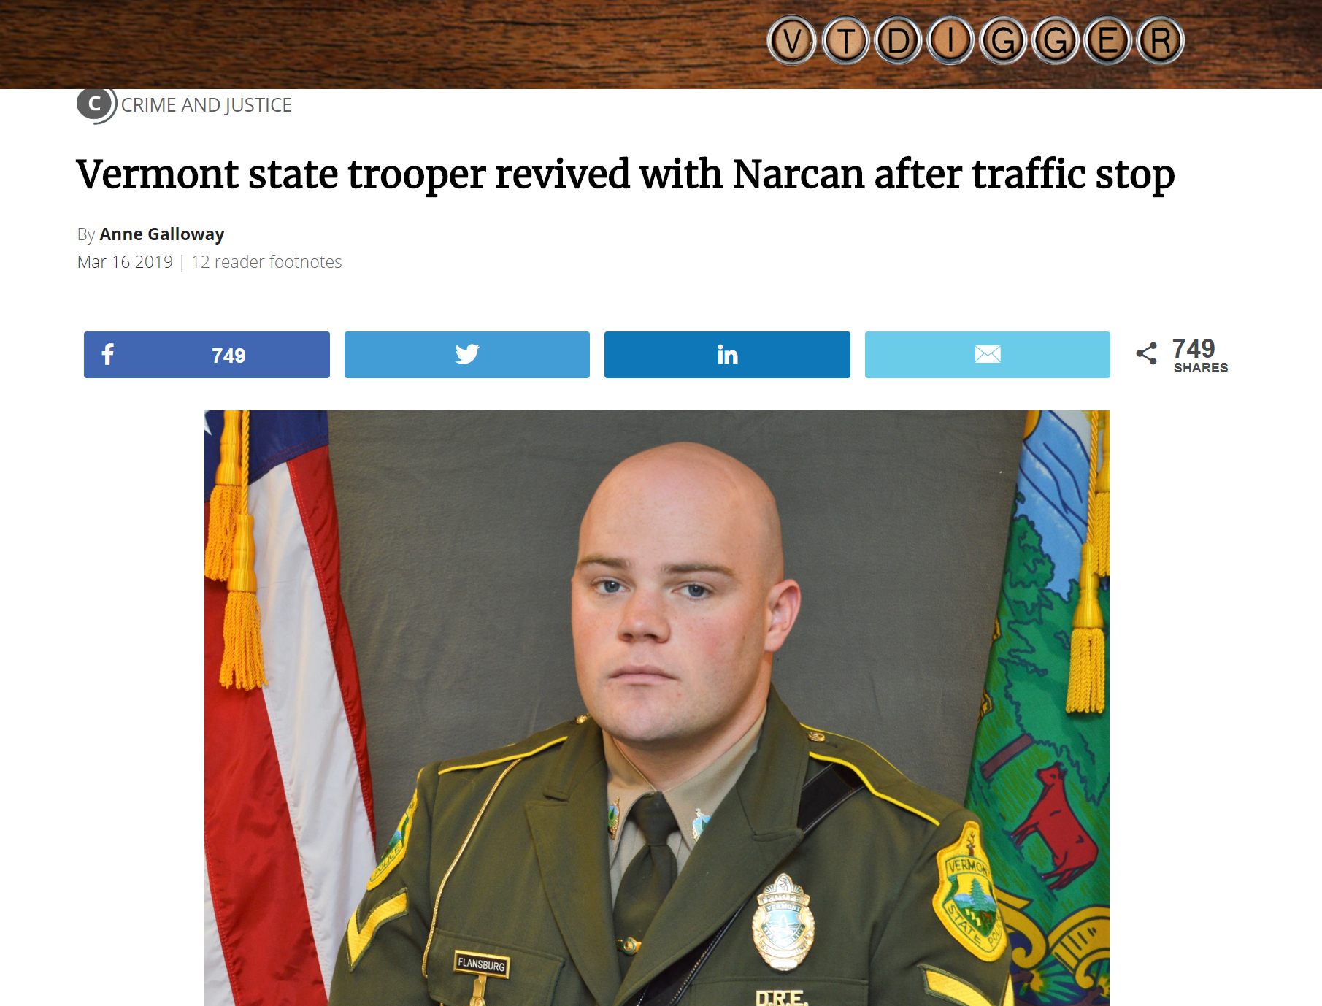
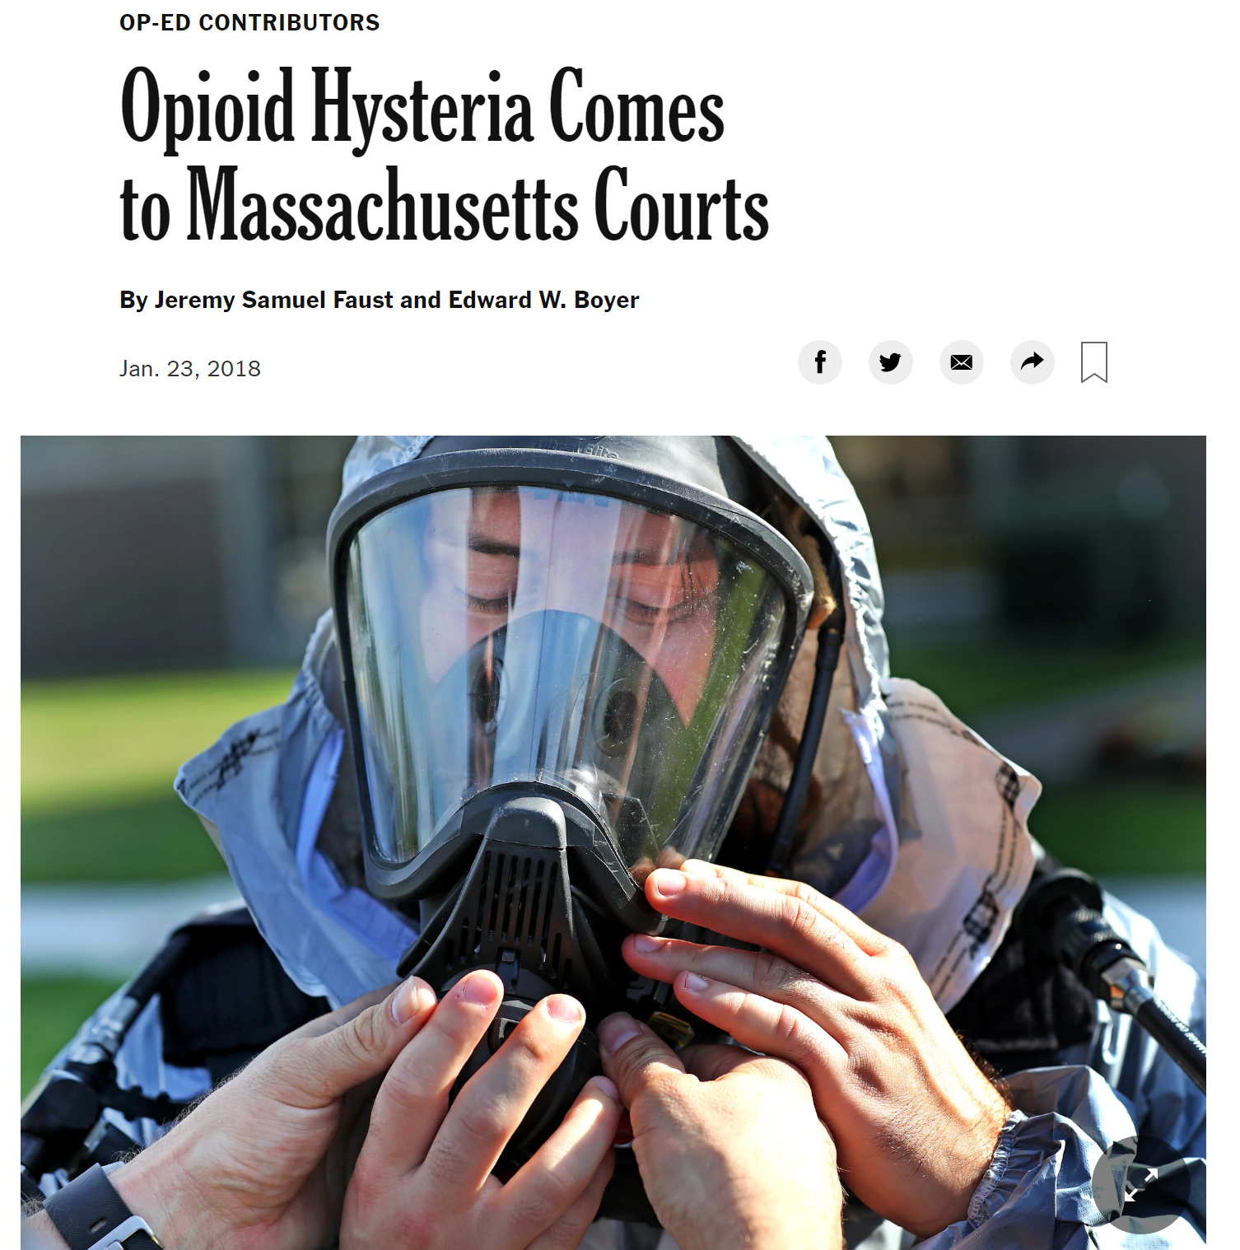
The Importance of Scientific Sources

Slide 11
The importance of imaging
This is how I’m viewed by the people I’m talking to.
This is how I perceive you perceiving me.
This isn’t my experience.

Slide 12
The importance of people first
Bridge the Gap of Understanding! I see people misunderstanding us all the time – assuming the worst… Get to know us, learn about us, we are the same as you, just dealing with this challenge.

Slide 13
Public Health Approaches to the Opioid Overdose Epidemic
Strategies that Dominate
Strategies that Work
Scare tactic-based primary prevention
Safe opioid prescribing & disposal
Pharmaceutical crackdowns & opioid reformulations
Tough love
Getting people “clean” with abstinence
Law enforcement approach
Comprehensive reality-based education
Harm reduction
Overdose Education & Naloxone Distribution
Overdose Prevention Sites / Safer Consumption Spaces
Opioid Agonist Therapy
Decriminalization
I detoxed, but relapsed…can't afford suboxone;
we need to take money from jails and put it into treatment
Notes:
All states but MO have PDMP. Missouri passed legislation in April 2017 to adopt state PDMP.
Several states have enacted legislation that will limit the number/day supply of opioids that can be prescribed (NJ, NY, MA, etc. NJ limits to 5 day supply)

