Slide 1
Opioid Media Toolkit Overview: A Tool for Journalists
Veronica Alexander, Policy Analyst, Center for Public Health Equity
June 20, 2019

Slide 2
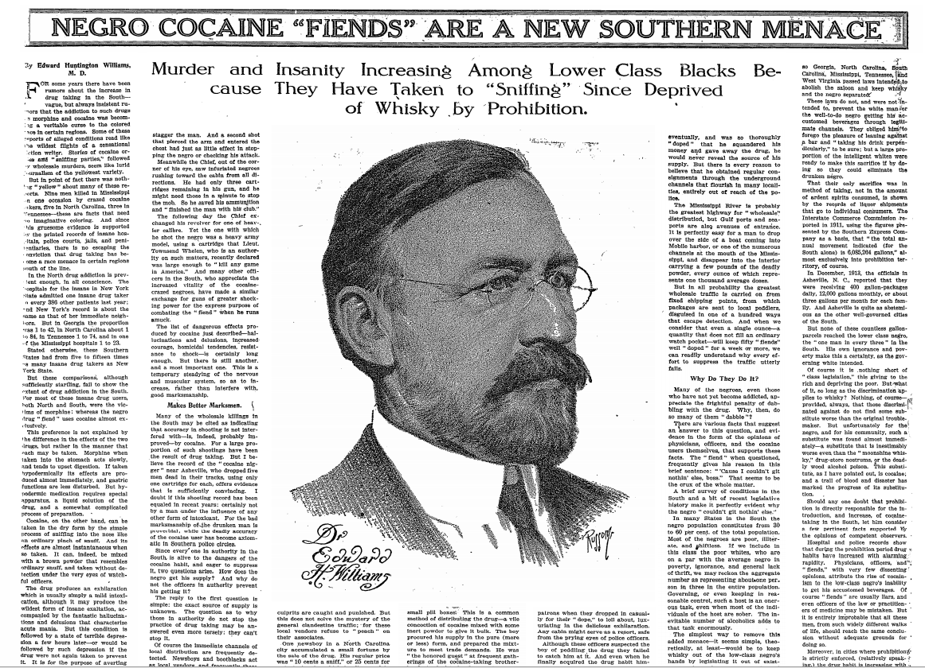
The Harrison Narcotics Tax Act and the Persistent Narrative of a “New Menace”
How reporting correlates to policy
Narratives used for drug policy reform
Justify prohibition or criminalization
Edward Huntington Williams, M.D. The New York Times, February 8, 1914
Notes:
This article appeared in the New York Times and its author was a distinguished physician. This article talked about crazed murder parties, cocaine making black impervious to bullets, and basically violent hulk like monsters. It drew a distinction between crazed cocaine users, whites who primarily drank alcohol which was not as accessible to blacks, creating a soon to be familiar us vs them/good vs bad racial demarcation about substance use. Between 1898 and 1914 numerous articles appeared exaggerating the association of heinous crimes and cocaine use by blacks. In some cases suspicious of cocaine intoxication justified lynchings. Around this time Congress was debating the Harrison Narcotics Tax Act, one of the first attempts at national drug legislation – to tax and regulate the production, importation, and distribution of opium and coca products and control the opium trade. It was opposed in the south re: states rights. The Harrison Tax Act was passed in 1914, the same year this article of the mythical negro cocaine fiend was published.

Slide 3
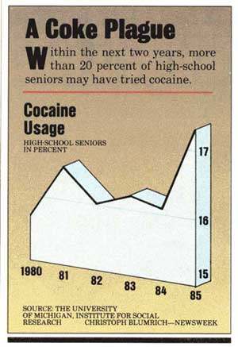
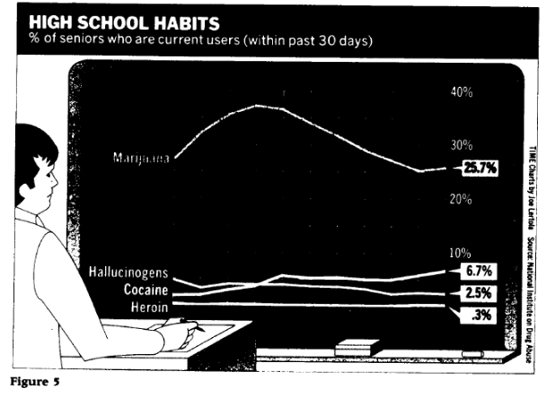
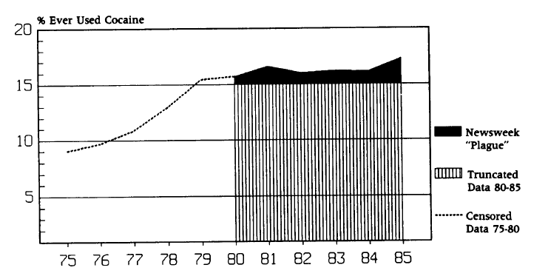
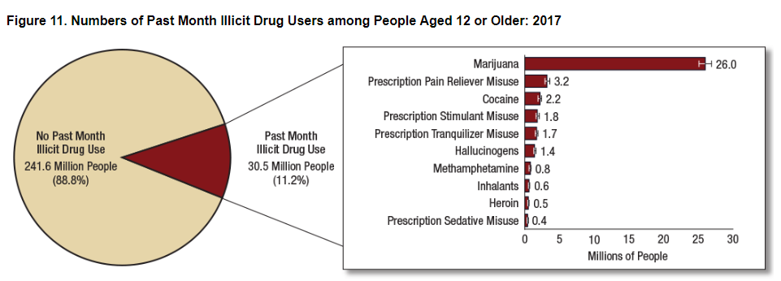
Misrepresented data and hyperbole
1. Coke Plague: Newsweek 1986 a:63, Christoph Blumrich.
2. . Newsweek editorial deletions: Shocking Numbers and Graphic Accounts: Quantified Images of Drug Problems in the Print Media, Orcutt and Turner, Social Problems Vol 40, No. 2, May 1993
3. Time 1986:64, Joe Lertola. Copyright 1986 Time Inc. 4. Substance Abuse and Mental Health Services Administration. (2018). Key substance use and mental health indicators in the United States: Results from the 2017 National Survey on Drug Use and Health (HHS Publication No. SMA 18-5068, NSDUH Series H-53).
Notes:
1. Coke plague: Newsweek 1986a:63, Christoph Blumrich
2. Newsweek editorial deletions: Shocking Numbers and Graphic Accounts: Quantified Images of Drug Problems in the Print Media, Orcutt and Turner, Social Problems Vol 40, No. 2, May 1993
3. Time 1986:64, Joe Lertola. Copyright 1986 Time Inc.
4.
First image: 1986 picture that accurately described the prevalence of drug use whereas the stories pushing the epidemic angle were truncated to remove that bump of usage in the 70s. Also included marijuana, which in itself was declining, to contrast with “hard” drugs. What they basically did was emphasize a minor and short term bump in 30-day usage (ignoring a larger increase that had happened and since leveled off in the 70s) which was cited as “dramatic,” effectively acknowledging illicit drug use had been declining while using a short term increase to predict an epidemic. That initial spike in the 70s did not receive comparable media coverage. Alcohol OR tobacco use dwarfed the rates of use of all illicit drugs combined (1 in 4 and 1 in 5 respectively). The percentage of young people who had ever tried cocaine peaked in 1982, four years BEFORE the “start of the epidemic and continued to decline thereafter. By all official measures, cocaine use was low to begin with and continued to decline throughout the “scare.”
In June 1986, stories about drug abuse accounted for 3.2% of all national media, then unprecedented. In that year, between the 3 major tv networks, they aired 74 evening news segments on drugs. 48 Hours on Crack Street. The NYT ran three front page series called “The Crack Plague.” All of this occurred while nearly every index of drug use was dropping, and had peaked four years before the start of this “epidemic.” By comparison, during this time period HIV/AIDS never accounted for more than 1.2% of overall coverage through the 80s and 90s. Crack use was low to begin with and only declined during this epidemic. Washing Post ran over 1500 stories between 88 and 89. Crack was called the most addictive drug known to man and said to cause instantaneous addiction. 66% of stories by The New York Times perpetuated at least one stigmatizing myth of crack users and had only decreased 30% by 1995.
2017: estimated 11.2% (1 in 9) Americans had used an illicit drug in the past month, primarily marijuana (30.5m all, 26m marijuana). Prescription pain relievers current misuse 3.2m (1.2%) aged 12 or older. Number excludes those with no fixed address, active duty military personnel, and those in prisons, nursing homes, mental institutions, etc.

Slide 4
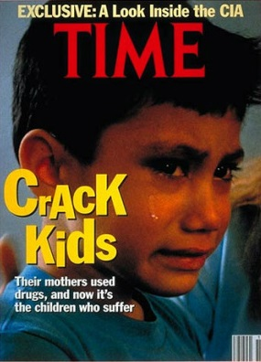
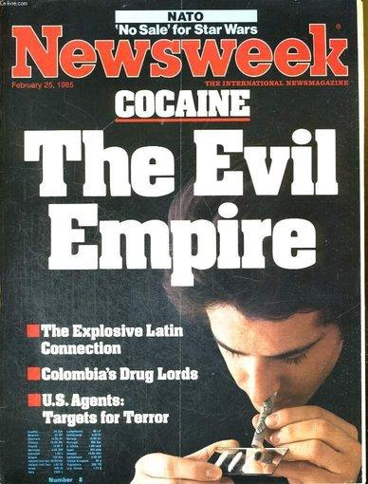
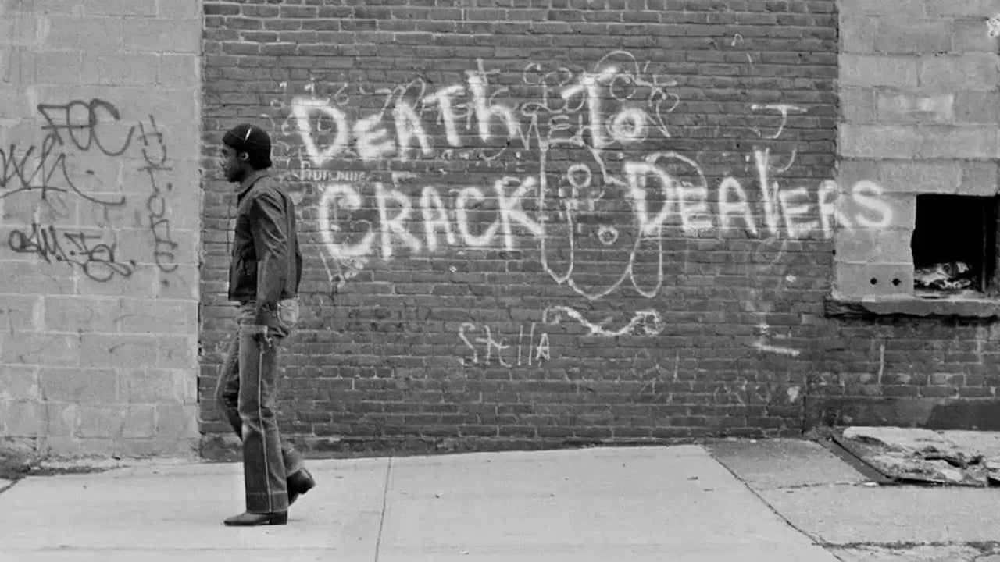
Welfare Queens, Superpredators, and Crack Babies
Notes:
August 6, 1989 Douglas J. Besharov
New York Times, May 9, 2018, Jennifer Egan
Time Magazine, Kids Addicted to Crack, May 13, 1991
New York Daily News as originally seen in the film The Seven 5
Racist arguments often originated from experts in the field; a prominent criminologist coined the term superpredator: juveniles “raised by deviant, delinquent, and criminal adults in abusive, violence-ridden, fatherless, godless, jobless settings” who would in time “do what comes naturally: murder, rape, rob, assault, burglarize, deal deadly drugs, and get high.”. A renowned pediatrician claimed that crack exposure in babies “wipes out the part of their brains that makes us human beings.” The former director of the US National Center on Child Abuse and Neglect predicted a “bio underclass” with “irrevocable and permanent brain damage, whether it is 5% or 15% of the black community. Keep in mind the percentage of cocaine users was already lower than that! A prominent conservative journalist (Charles Krauthammer, who recently passed) said “a cohort of babies is now being born whose future is closed to them from day one. Theirs will be a life of certain suffering, of probably deviance, of permanent inferiority. At best, a menial life of severe deprivation, and this is all biologically determined from birth.” Washington Post: “a potential human plague almost too horrible to imagine.” Rolling Stone: recommended putting cocaine exposed babies “in a crib, turn out the lights, and keep your distance,” advice that is impossible to imagine being given to white mothers to deprive babies of all stimulus and be ignored in a dark room. The “crack baby” study was based on 23 participants and did not look at the effects of powder cocaine use on infants and was eventually recanted. More susceptible to SIDS based on small sample sizes, later debunked; modern longitudinal studies show little or no developmental differences in cocaine exposed babies.
What does this say about what sources and experts the press is quoting to drive their chosen narratives?
Krauthammer said “there might be a better solution fairer to both mother and child but no one can find it.” Today we managed to “find” that humane treatment and a healthcare perspective is a better solution to addiction. When you use rhetoric that is premised on the biological determination, that people have certain genetic predispositions that are not affected by social and outside intervention, it elides discussion of preventative or therapeutic treatment.

Slide 5
Crack Cocaine vs. Opioids
Notes:
Crack headlines (to be read aloud): 1/1/85 through 12/31/90, a year before the beginning of the so-called crack epidemic and prior to the 1986 elections through 1990, when coverage began to wane after the 1988 election. Opiates: 1/1/07-12/31/14, which opioid overdoses had already increased 130% since 1999 and fentanyl involved overdoses shot up 151% which is clearly a real health epidemic.
Vocabulary of attribution: drugs, especially crack, threatened all the central institutions in American life: families, communities, schools, businesses, law enforcement. Routinization of caricature: worst cases framed as typical cases, the episodic rhetorically recrafted into the epidemic. Drug so poisonous that air itself is unsafe to breathe, matricide, a pervasive atmosphere of fear, violence, and crime. Drug dealers were depicted as flashy predators running business empires, welfare queens depicted as “living large” on government benefits. “Plague,” “epidemic,” “decay,” “crisis,” “eating away at the fabric of America”. Threat that drug use was going to go into the suburbs when it was largely confined the urban cities.
Coverage of opioid users: drug use or addiction is painted as novel or surprising; that such a thing could happen to a “good” person with so much potential.
Historical denial of drug use in white communities helps maintain the notion that whites are law abiding upstanding citizens as well as contrasting to the immorality of the inner city.
The underlying tone is one of regret, that a “good” life was squandered.
The etiology of one’s drug use is normally explored, which is often missing in non-white drug users
Their drug use is explained in ways that leave them blameless and victims of circumstance
White drug users are contrasted to “real” addicts, dirty homeless people on the street, but a “normal” person dealing with misfortune.
Called an “epidemic of despair,” “deaths of despair.” The criminalization of users is absent.
Focuses on big pharma, treatment, and medical uses; majority of those diagnosed with OUD were exposed to four or more classes of drugs with first age of exposure at age 12 and more than 50% of people with OUD get their drugs for free from a friend of family member.

Slide 6
“The Nixon campaign in 1968, and the Nixon White House after that, had two enemies: the antiwar left and black people. You understand what I’m saying? We knew we couldn’t make it illegal to be either against the war or black, but by getting the public to associate the hippies with marijuana and blacks with heroin, and then criminalizing both heavily, we could disrupt those communities. We could arrest their leaders, raid their homes, break up their meetings, and vilify them night after night on the evening news. Did we know we were lying about the drugs? Of course we did.”
John Ehrlichman, former legal counsel for the Nixon administration “Legalize It All,” Dan Baum, Harper’s Magazine, April 2016

Slide 7
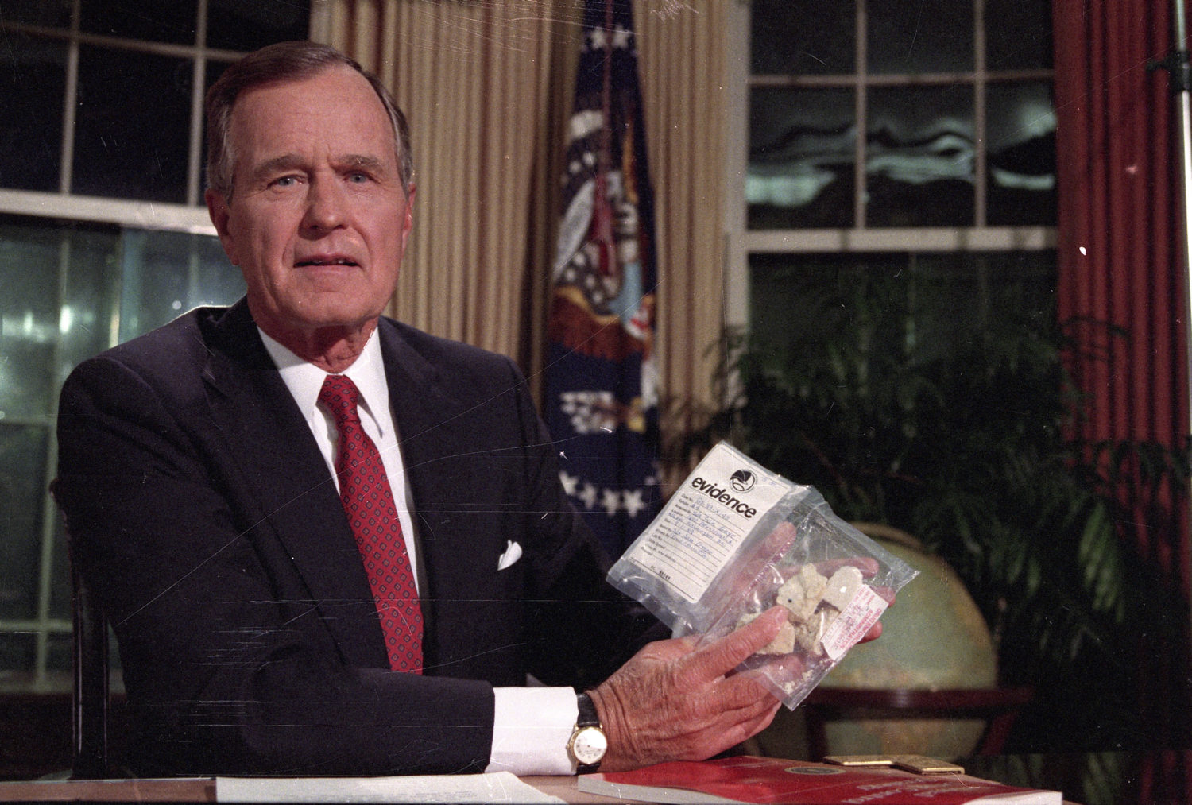
https://www.youtube.com/watch?v=2m2FN0q60T8&t=2s
Notes:
This was his first major primetime address to the nation broadcast on all 3 networks. The annual federal budget for antidrug efforts surged from less than $2 billion in 1981 to more than $12 billion in 1993. The budget for the DEA quadruped between 1981 and 1992. The Bush administration alone spent $45 billion, more than all other presidents since Nixon combined mostly on law enforcement. This naturally front page news the next day. They said they “liked the prop” and decided it should be bought in the park across the street from the WH so the president could say that crack had become so pervasive it was being sold “in front of the WH.” They were not able to find anyone selling crack in the area and had to entice someone to come to the park to make the sale – a 17 or 18 year old high school senior who didn’t even know where the WH was. There is a recording of the DEA talking to him and he says “where the f is the WH.” They had to manipulate him to get there Nobody would sell crack there because among other reasons there would be no customers, because crack use was in the poor neighborhoods not close to the WH.
In January 1985, 23% of polled Americans cited “nuclear war” as the most important problem in the country; less than 1% believed drugs were an important problem. In 1989, 64% of Americans cited drug use as the country’s most important problem, with nuclear war downgraded to just 1%. In 1990, concern for drug use again dropped to 10%. The consistency with which the media manipulated Americans’ views during the drug war is both stark and readily apparent.
Laws: There had previously been 55 mandatory minimums for criminal sentencing. With the Anti Drug Abuse Act of 1986, 29 new mandatory minimums were implemented all relating only to drug offenses. They were designed to apply distribution level import/export offense sentencing to low level offenders.

Slide 8
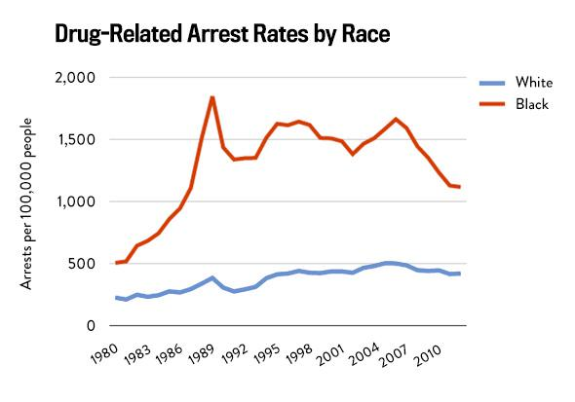
The New Jim Crow
Source: The Sentencing Project
Notes:
Crack cocaine being “100 times more powerful” than powder cocaine → 100x longer sentencing for an identical drug. Narcotics offenses increased eightfold from 1986 and incarceration rates tripled.
1980: drug arrests rise 126% with blacks arrested at five times the rate of whites, 13x more often today and as high as 57x more often in some states. Prior to the War on Drugs, the incarceration rate remained stable for at least 50 years at 110 per 100k. By 2008 it was 751 per 100k, roughly over half of which are federal drug offenses. Today the rate is 655 per 100k. Blacks and latinos represent more than 75% of drug law violators in state and federal prisons.
Black women are up to 10x more likely to be reported to child welfare services for suspected drug use. # of kids in foster care had dropped in 1980 due to Child Welfare Act, but drug laws reversed this trend and outpaced previous levels of growth (from 302k in 80 - to 262k in 82 - then 300k in 87, 400k in 90.) Number of children in foster care due to prenatal drug exposure increased 25%; by 1990 more than 60% of children in foster care were children of color. Today black people are still twice as likely to be prosecuted under mandatory minimum sentences than whites and more than 61% of women in federal prison are there for drug convictions with black women being more than twice as likely to be criminalized for drug law violations than white women.
Felony convictions bar access to public housing. You may not enlist in the military. You may not receive federal benefits such as SNAP, TANF, and educational aid even for just possessing marijuana. You may be re-arrested for possessing a firearm. You are disqualified from fostering or adopting a child. You cannot serve on a jury. You are blocked from most government security clearances, and any employment subject to federal regulation.
Of the six million Americans disenfranchised as of 2016, 38% are black (1 in every 13 black Americans, four times as much as any other race). That’s more than 7% of the black population compared to less than 2% in any other racial group. More than ten states have disenfranchised more than 20% of their black men. These rates vary by state and are not consistent across the board. Florida alone accounts for 27% of all disenfranchised Americans. And this is often permanent; America is the only country to deprive citizens of the right to vote after they have completed their setnences.

Slide 9
Stigmatizing Language in News Media Coverage of the Opioid Epidemic Implications for Public Health.
“In a 2017 national survey, only 27% of Americans reported viewing a person using opioids as deserving, as opposed to worthless. Stigmatizing attitudes are correlated with lower support for evidence-based public health policies […] and higher support for punitive policies. [T]he public is unlikely to support policies to benefit – instead preferring to punish – highly stigmatized groups.”
McGinty, E.E. et al. John Hopkins School of Public Health. 2019
Notes:
News stores are far more likely to included stigmatizing terms than less stigmatizing terms:
Of 6,399 identified stories, 49% mentioned one or more stigmatizing words
2% mentioned one or more alternative, less stigmatizing words
Increase of 37% in July 2008- June 2009
59% during July 2013-June 2014
45% July 2017-June 2018
“Addict” was the most frequently mentioned stigmatizing term
“junkie” mentioned 3%
“clean” mentioned 14%
Inclusive of “potentially” stigmatizing terms increases usage to 53%
Use of stigmatizing terms: 46% print news, 61% opinion editorials, 54% television news

Slide 10
Contents of the Opioid Toolkit
History of Media Coverage Influencing Public Policy
Accurate Depiction of Opioid Epidemic
Harm Reduction Innovations
Destigmatizing Narrative Framing

Slide 11
Transformative Justice in Reporting

