Slide 1
The Drug War
Past & Present
Kareem Butler, MPH
2020 Census Project/Policy Coordinator
Chicago Urban League

Slide 2
The Harrison Narcotics Act 1914

Slide 3
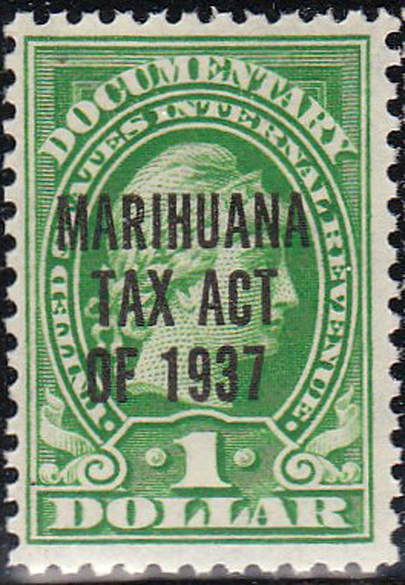
The Marijuana Tax Act 1937

Slide 4
“Reefer makes darkies think they’re as good as white men”
- Harry J. Anslinger, Commissioner of Federal Bureau of Narcotics
“We knew we couldn’t make it illegal to be either against the war or blacks, but by getting the public to associate the hippies with marijuana and blacks with heroin, and then criminalizing both heavily, we could disrupt those communities. We could arrest their leaders, raid their homes, break up their meetings, and vilify them night after night on the evening news. Did we know we were lying about the drugs? Of course, we did.”
- John Ehrlichman, Counsel and Domestic Policy Affairs Chief, Nixon Administration

Slide 5
Timeline
1971
Nixon declares drug-use “public enemy number one”
1973
The Drug Enforcement Agency (DEA) Created
1981
Reagan Expands the War on Drugs
1987 - Present
Inequitable criminal justice and public health outcomes
1986
Cocaine/Crack Disparity
1914 & Jim Crow
The Harrison Act
1937
Marijuana Tax Act

Slide 6
A Legacy of Racism

Slide 7
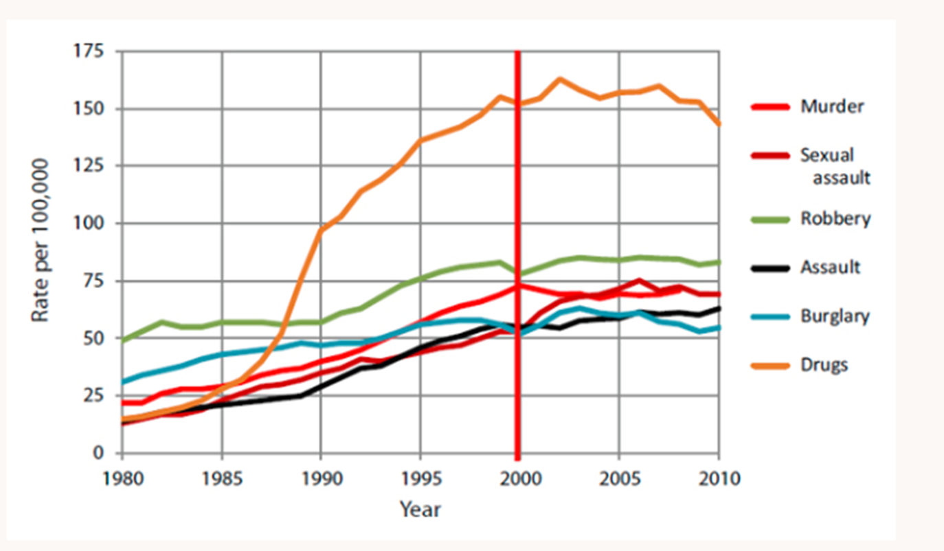
Changes in Trends: Arrest by Offense Type

Slide 8
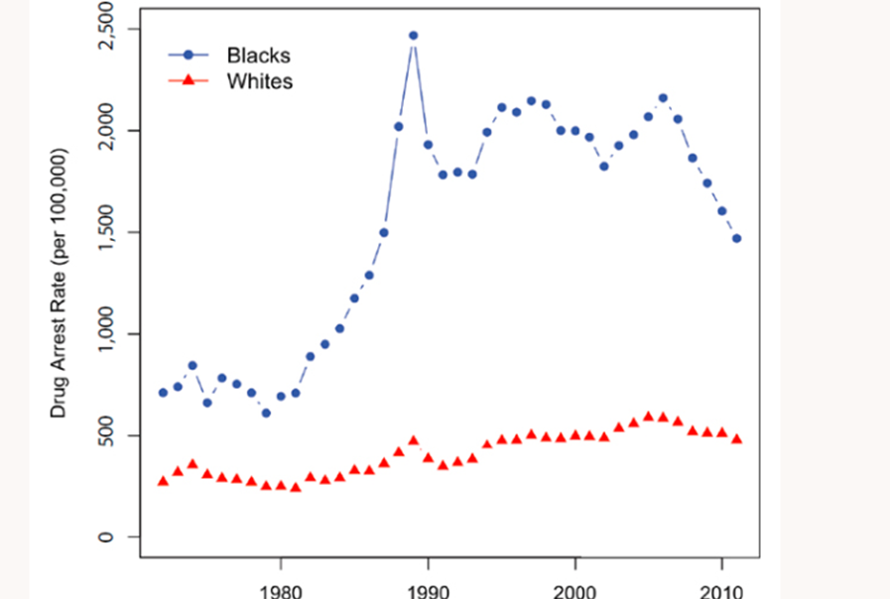
Changes in Trends: Drug Arrests by Race

Slide 9
A New System of Jim Crow and a Public Health Crisis ….
A modern crisis reducing access to community-based treatment, and disproportionately harming the poor and communities of color
Nearly 80 percent of people in federal prison, and 60 percent of people in state prison for drug offenses are African-American or Latino
Correctional facilities worsen drug-user health and drug-use disorders, making returning citizens far more likely to experience overdose

Slide 10
Overdose and Health Equity

Slide 11
Access to Overdose Prevention is About Total Racial Equity…
Racial minorities and people living in poverty have unmet treatment needs
In 2017, African Americans living in Chicago were nearly 2X more likely than their White counterparts to experience a fatal drug overdose
Those living under conditions of “High” economic hardship were similarly OVER 2X more likely Than Wealthier peers to experience a fatal drug overdose
In Illinois, newly diagnosed cases of HIV among injection drug-users were 46 percent more common among African Americans than Whites
African Americans are also 33 times less likely to be prescribed buprenorphine
Notes:
I think that black folks are 33 times less likely to be RX buprenorphine

Slide 12
Overdose Prevention Sites Work
Overdose Prevention Sites provide communities with compassionate and secure spaces to avoid overdose, provide drug-user education, and reduce the spread of communicable diseases
They often serve the most vulnerable among us including those facing mental health challenges, and those experiencing homelessness
Insite, Vancouver’s largest OPS was associated with a 35 percent reduction in overdose deaths in the immediate area of the facility, compared to a 9 percent reduction throughout the rest of the city
Overdose Prevention Sites demonstrate reductions of over 50 percent in new cases of HIV and Hepatitis C
Notes:
Use Overdose Prevention sites

Slide 13
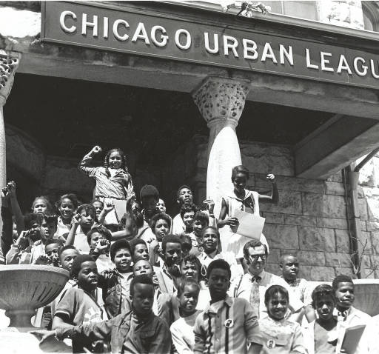
The Chicago Urban League: Total Racial Equity
The Chicago Urban League is committed to advancing racial equity in all-parts – Health, Criminal Justice Reform, Education, Prosperity, and Housing
Notes:
Defelonization for personal use
Good Samaritan amendments to make calling 911 easier in event of overdose
We also co-host naloxone training with CRA
We will be releasing a report on the state of AA opioid OD deaths.

Slide 14
A Snapshot of Our Drug Policy Work
Defelonization of possession for personal use
Good Samaritan Amendments to make calling 911 easier during overdose
Co-hosting Naloxone training with CRA
Releasing Report on State of African American Opioid Deaths

Slide 15
By creating secure and compassionate spaces to prevent overdose, Overdose Prevention Sites help reduce African American communities’ contact with the criminal justice system and bring us one step closer to total racial equity

