Slide 1
The State of CHW Employment and Funding in Cook County
Sinai Urban Health Institute
Health & Medicine Policy Research Group
Illinois Community Health Workers Association

Slide 2
Welcome Helen Margellos-Anast, MPH President, Sinai Urban Health Institute

Slide 3
Agenda
Welcome
Helen Margellos-Anast, President, SUHI
Community Health Workers and the Act: Where are we now?
Leticia Boughton Price, President, ILCHWA
Community Health Worker Common Indicator Employer Survey
Stacy Ignoffo, Executive Director, Community Health Innovations, SUHI
Patricia Labellarte, Senior Evaluator, SUHI
Community Health Workers: Sustainable Funding
Anna Yankelev, Director of Strategic Workforce Initiatives, HMPRG
Angela Eastlund, Senior Workforce Policy Analyst, HMPRG
Q & A

Slide 4
Community Health Workers and the Act: Where are we now? Leticia Boughton Price, CHW, MSW President, Illinois CHW Association

Slide 5
Overview
The Act:
Year the bill was passed
The three components of the bill
What’s been done so far
Current state of CHWs
How you can help

Slide 7
ILCHWA Mission and Vision
Mission: Unify community health worker (CHW) voices statewide
Vision: A full-service membership association that…
Serves as a statewide clearing house
Advocates for policies and best practices that positively impact CHWs
Connects CHWs to resources to address the social determinants of health and well-being
Amplifies the collective capacity of CHWs
Promotes professional development and certification
Addresses membership concerns through peer-to-peer support and networking

Slide 8
ILCHWA Milestones
2014 - Illinois signs first CHW legislation adopting a standard definition for CHWs, creating the Illinois CHW Advisory board and recommendations for the advancement of the CHW workforce in Illinois
2015 - Illinois CHW Advisory Board creates recommendations regarding core competencies and skills, workforce development, financing and reimbursement, and certification and training
2015 – Chicago CHW Local Network becomes Illinois CHW Association and is recognized by the State of Illinois
2018 – ILCHWA becomes a registered 501(c)(3) organization
2018 – ILCHWA partners with Illinois Department of Public Health (IDPH) and Illinois Public Health Association through CDC
2019 – CHW road show across the state, to discuss current relevance of 2015 recommendations
2021 – HB 158/Now Public Act 102-0004 signed into law; incorporates CHW certification through IDPH and reimbursement for CHW activities through HFS/Medicaid

Slide 9
Illinois Health Care and Human Service Reform Act
Highlights
To improve health care access and health outcomes for underserved communities, the Act calls for increased access to CHW services to address disparities in chronic disease management.
Creates new opportunities for CHW services to be reimbursed by Medicaid, creating a sustainable funding stream for CHWs in Illinois.
Directs IDPH to implement key provisions of the Act related to training, certification, and reimbursement in partnership with a statewide CHW association.
Created the Community Health Worker Review Board, to create a statewide certification program to be administered by IDPH.
Read our report Illinois Community Health Worker Roundtables: Recommendations for the Community Health Worker Certification and Reimbursement Act in English and Spanish

Slide 10
Current State of CHWs in Illinois
Challenges
Sustainable funding
Lack of identity and CHW integration
Increased interest across the state in growing and sustaining the CHW workforce:
HRSA training grants
Health transformation grants
CDPH – Community Health Response Corps
CCDPH – Building Health Communities CHW strategy
IDPH-Illinois CHW Review Board
Appointed membership
Meetings
What you can do:
Advocacy sign-on letter

Slide 11
Save the Date
ILCHWA’s 1st Annual Summit
September 15, 2023, 9am to 3pm Arturo Velasquez Institute
September 29, 2023, 9am to 3pm University of Illinois at Urbana-Champaign
Stay Connected
Get involved with ILCHWA:
Email: ilchwa2018@gmail.com
Website and membership information: https://ilchwanetwork.wordpress.com/ilchwa-membership

Slide 12
Community Health Worker Common Indicator Employer Survey Sinai Urban Health Institute

Slide 13
Background
First Community Health Worker Common Indicator Employer (CHW-CI) survey conducted in Illinois
Funding and support from:
National Association of Chronic Disease Directors
CHW Common Indicators project leadership team
Lloyd A. Fry Foundation

Slide 14
CHW-CI Survey Team
Notes:
The Community Health Worker - Common Indicator Employer Survey (CHW-CI) 2022 was created and disseminated through a collaborative effort between the following organizations: Illinois Department of Public Health (IDPH), Illinois Community Health Workers Association (ILCHWA), Sinai Urban Health Institute (SUHI), Health and Medicine Policy Research Group (HMPRG), and Illinois Public Health Association (IPHA).

Slide 15
Methods
Administered to organizations that employ or work with community health workers (CHWs) in Illinois
Electronic REDCap survey
English and Spanish
October – December 2022
Notes:
Administered to organizations that the survey team identified as having employed or worked with CHWs

Slide 16
Strengths and Limitations
What these data tell us
Confirm assumptions about landscape and funding for CHW positions in Illinois
Provide information to compare Illinois to other states
What these data don’t tell us
What proportion of CHW programs in Cook County are represented in these data
Progress or change over time
Notes:
Why did we conduct this survey? To confirm our assumptions about CHW positions. are primarily grant-funded and that CHWs are paid low wages.
Limitations include the fact that the CHW-CI Employer Survey Data Team does not know what proportion of all CHW programs in Cook County, Illinois or Illinois as a whole are represented in these data. The CHW-CI Employer Survey Data Team also cannot make comparisons to previous data since this is the first implementation of the survey.

Slide 17
Results from Cook County, Illinois

Slide 18
Respondents
61 organizations
46 complete responses
15 partial responses
Respondents reported their organization both:
Employs CHWs
Serves Cook County
Notes:
Responses from 61 organizations are included in this analysis

Slide 19
Types of Organizations

Slide 20
CHW Titles
Additional titles: Lifestyle Coach, Community Educator, Community Advocate, Public Health Ambassador, Community Health Outreach Worker, Community Health Promotor, Peer Health Navigator, Peer Support Specialist, Working with children & families in the childcare center, Patient & Communications Coordinator, Food Allergy Educator, AmeriCorps Member Position
Notes:
Organizations were asked to indicate all job titles that they give to their CHWs

Slide 21
CHW Earnings and Benefits

Slide 22
CHW Earnings – Hourly Rates
Full-time CHWs
Range: $17.00 - $36.36
Average: $22.42
Part-time CHWs
Range: $16.00 - $35.00
Average: $22.27
Notes:
These figures were calculated from respondents that reported their earnings of their organization’s CHWs in hourly wages, rather than annual salary
Average for full-time = $46,633.60 annually, for a 40-hour work week
Average for part-time = $46,321.60 annually, for a 40-hour work week
[if asked]: 41 respondents provided information about CHW earnings

Slide 23
CHW Earnings – Annual Earnings
Full-time CHWs
Range: $35,000 - $59,550
Average: $42,230
Part-time CHWs
Range: $20,000 - $55,000
Average: $40,350
Notes:
These figures were calculated from respondents that reported the earnings of their organization’s CHWs in annual salary, rather than hourly wages

Slide 24
CHW Earnings – Contracted CHWs
Full-time
Average hourly rate: $22.89
Part-time
Average hourly rate: $22.35

Slide 25
Contracted CHWs

Slide 26
Benefits Provided to CHWs
Notes:
81% of organizations provided at least one benefit to their full-time CHWs, and 56% of organizations provided at least one benefit to their part-time CHWs.
Most common benefits for full-time CHWs: health insurance, vacation, and dental insurance
Most common benefits for part-time CHWs: transportation or mileage reimbursements, sick leave, and vacation

Slide 27
Benefits Provided to CHWs

Slide 28
Sustainable Funding

Slide 29
Sustainable Payment Mechanisms
18 (64%) of 28 respondents reported that none of their funding for CHW programs comes from a “sustainable” source
5 respondents (18%) indicated that over half of their CHW program(s) are funded via “sustainable” mechanisms

Slide 30
Barriers and Challenges
"A huge number of our current CHWs are covered by grant funding as the result of the pandemic. We anticipate that many of these positions will go away as this funding ends.”
“We are entirely supported by donations; the "sustainable" funding types listed are not available to free clinics.”
“We have diversified our funding streams through individual donations and multiyear grants. Many opportunities arose due to COVID-19 and we have been successful being awarded new grant opportunities. A barrier to this will be the shift in philanthropy.”

Slide 31
Barriers and Challenges
“Our [organization’s] only option is to continue applying for all grant opportunities that relate to CHW work, whether it be small projects or long-term programs.”
“We aren't aware of sustainable funding sources for CHW’s [sic]. We currently have funding from the city and that last[s] for 5 years. We will spend the remainder of those 5 years looking for sustainable funding sources. As a non-health entity, it's difficult to find funding that we qualify for.”

Slide 32
Progress Made
“We are interested in exploring alternate payment methods and MCO [Managed Care Organization] support for this work given that so many of our patients are covered by Medicaid Managed Care.”
“[Our organization is] look[ing] at ways to create sustainable funding through internal department supports[,] post grant funding….imbedding [sic] workflows that allow for opportunities within existing programs…leveraging partners to buildout [sic] systems that allow us to track services in efforts to possibly bill for Z codes down the line.”

Slide 33
Progress Made
“Our organization is looking at incorporating other streams of funding to aid in sustainability such as foundations.”
“We have advocated with funding sources to include payments for non clinical care models related to SoDH [sic] [social determinants of health].”
“We have…convened a multidisciplinary workgroup focused on contracting with payors such as Medicaid MCOs, state Medicaid regulators, and our own ACOs [Accountable Care Organizations] to reimburse for CHW services. We hope to begin contracting in 2023, at least in initial markets.”

Slide 34
Successes
“…[CHW salary and benefit costs at our organization covered by “sustainable” funding sources]…are part of a project where our Accountable Care Organizations fund the salary for CHWs working specifically with attributed patients (in our case, Dual-Eligible patients in the Medicare Shared Savings Program).”
“[Our organization] launched a remote care management team in March of 2021 to address the ongoing need and community burden of Medicare beneficiaries with health needs related to chronic diseases. Staff time spent with patients is reimbursable under the CMS Fee Schedule for CPT codes 99490 and 99439. This program is set to expand to include additional Medicare beneficiaries and patients with other health plans.”
Notes:
CHWs working with Medicare patients

Slide 35
Successes
“The 22% [of our organization’s CHW salary and benefit costs] that are listed as sustainably funded fall into the category of staff working in our value based care models. These staff are paid for through capitation arrangements. We are working towards having more of our patients under value based care, but it hasn't happened yet. The primary barrier is the way that FQHCs are paid. We hope that with the new APM [alternative payment model] that HFS [Illinois Department of Healthcare and Family Services] is proposing for 2023, we will have more success.”
Notes:
CHWs working with Medicare patients

Slide 36
Successes
“Some of our [organization’s] locations…have private funders that are committed to the regions they support. Other sites [that are part of our organization] in the City of Chicago have government funding or general operating funds from private foundations.”
“Our CHWs are primarily funded by grants, with a small portion covered by operating dollars. To get more covered by operating, we engage in robust research evaluations to prove their value and cost savings to the organization.”

Slide 37
CHW Training

Slide 38
Core Competency Training Requirements
Notes:
Respondents were asked if their organization requires CHWs that are hired to complete a state or CHW association/network-recognized CHW core competency-based training program, either before or after hire, of which 64% stated that they do.

Slide 39
Support for Core Competency Training
Notes:
Respondents were asked if their organization requires CHWs that are hired to complete a state or CHW association/network-recognized CHW core competency-based training program, either before or after hire, of which 64% stated that they do.

Slide 40
Accessing the Full Report

Slide 41
Full Reports – Coming Soon!
Reports of survey results from CHW employers in:
Cook County
Illinois
We will email instructions on how to access these reports, once they are published

Slide 42
Implications

Slide 43
Implications of Report Findings
Continue to characterize the CHW landscape in Illinois and Cook County with subsequent surveys.
CHW-focused survey launching very soon!
Work towards a more standardized CHW model in terms of:
definition
aligning roles with the national competencies for CHWs
training and career development
Ensure consistent living and thriving wages, and but also comprehensive benefits for CHWs
Pursue more sustainable funding mechanisms across all sectors
Notes:
– this is particularly important as the end of the public health emergency and pandemic response funds dry up, and organizations have to make hard choices by letting go their community health staff; who played a crucial role during the pandemic. Illinois passed legislation in 2021 to develop CHW certification and reimbursement procedures, and has convened a CHW Review Board to advise on these processes, but we don’t yet have specifics or guidelines.

Slide 44
Community Health Workers: Sustainable Funding Health & Medicine Policy Research Group

Slide 45
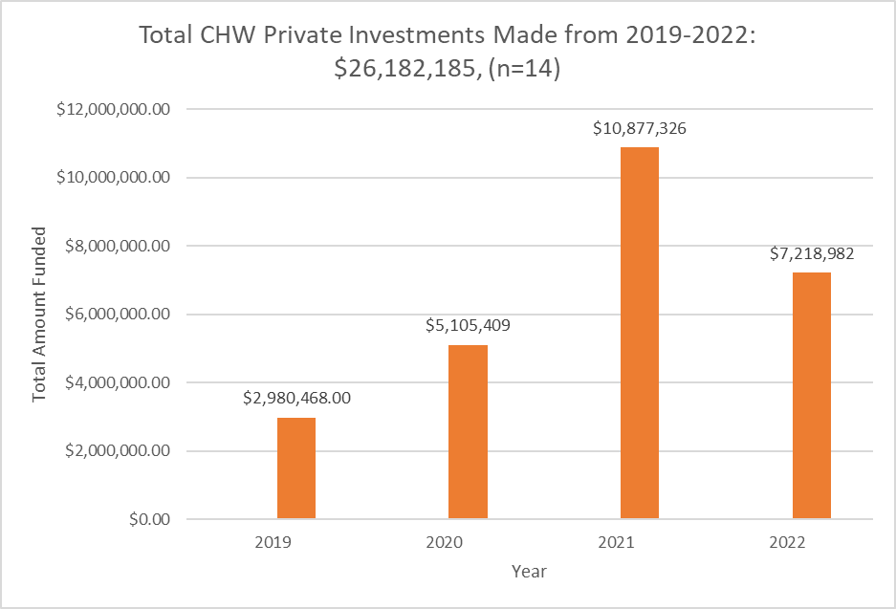
Total CHW Private Investments from 2019-2022 across 14 Foundations
Figure 1: Total CHW Private Investments Made from 2019-2022: $26,182,185. This bar graph shows total amount of CHW investments from 14 major private foundations from 2019-2022. This data might include double counts and should be interpreted as an estimate of funding from 2019-2022.

Slide 46
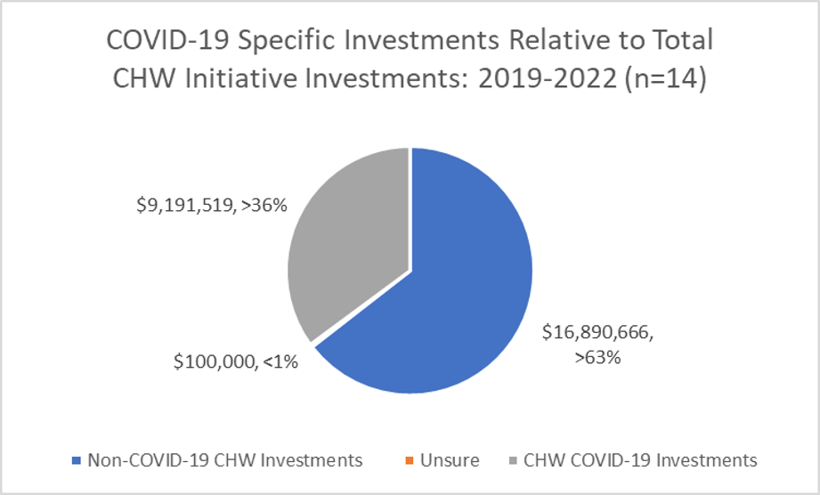
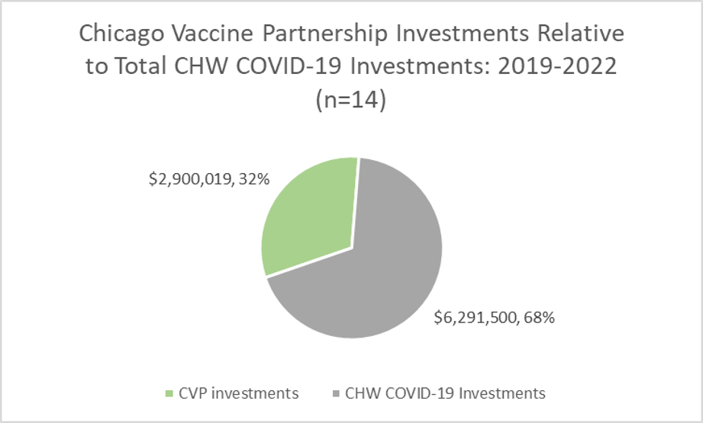
Total Amount of CHW COVID-19 Response Investments from 2019-2022 across 14 Foundations
Figure 2: Total CHW Covid-19 Response Investments 2019-2022. This pie graph shows the amount of CHW COVID-19 response funding that was made in relation to the non-covid-19 CHW investments made from 14 foundations. Of the total $26,182,185 invested, $9,191,519 went towards CHW COVID-19 response grantees.
Figure 3: Chicago Vaccine Partnership Investments Relative to Total CHW Covid-19 Investments 2019-2022. This pie graph shows the amount of CHW COVID-19 response funding that was made in relation to amount that was funded through the Chicago Vaccine Partnership (CVP). Of the total $9,191,519 invested towards CHW COVID-19 response grantees, $2,900,019 was a part of the CVP.

Slide 47
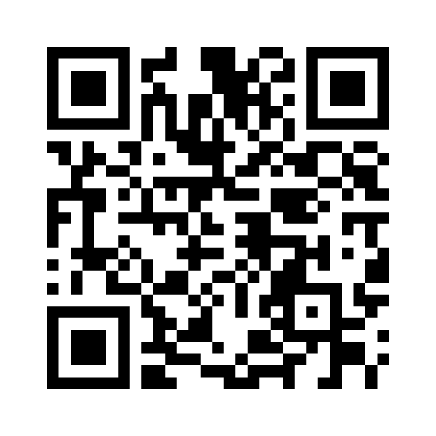
Menti Poll
Scan the QR code
or
Go to Menti.com and enter the code provided

Slide 48
Braided Funding: Unsustainable vs. Sustainable
Unsustainable:
Private grant funding
Public grant funding
Block grants
Cost savings elsewhere in organization (ROI)
Notes:
Put in chat: # of chws at your organization, percentage of funding that supports CHW roles that fit into this category of "unsustainable"
Braided funding strategies
Current strategies all fall under "unsustainable" category
CHW role is often broad in scope – often funding doesn't cover full cost of employment
Why legislation was necessary to open up a new funding stream for CHWs

Slide 49
Braided Funding: Unsustainable vs. Sustainable
Sustainable: Medicaid funding
Present:
Diabetes Prevention Program services
Managed Care Organizations (MCOs) –
Administrative expenditures
FQHC total cost proposal per visit rate
Notes:
Sustainable: doesn't mean perfect, but it is more predictable income stream from a longevity perspective than the unsustainable category
Important to note – Medicaid funding will not fix all of the issues, it is simply one more piece of the puzzle

Slide 50
Braided Funding: Unsustainable vs. Sustainable
Sustainable: Medicaid funding
Future: (Pending state certification processes)
State Plan Amendment (SPA) – a lasting change to IL Medicaid
Rhode Island SPA example
Fee For Service billing
Subject to appropriations
Clinical vs. community-based CHWs:
What does this mean for CHWs not employed by Medicaid providers?
Notes:
Rates: 15 min units, individual vs group rates
HUB model
Requires SSN
Things we're still looking into:
Z codes -
1115 Waiver

Slide 51
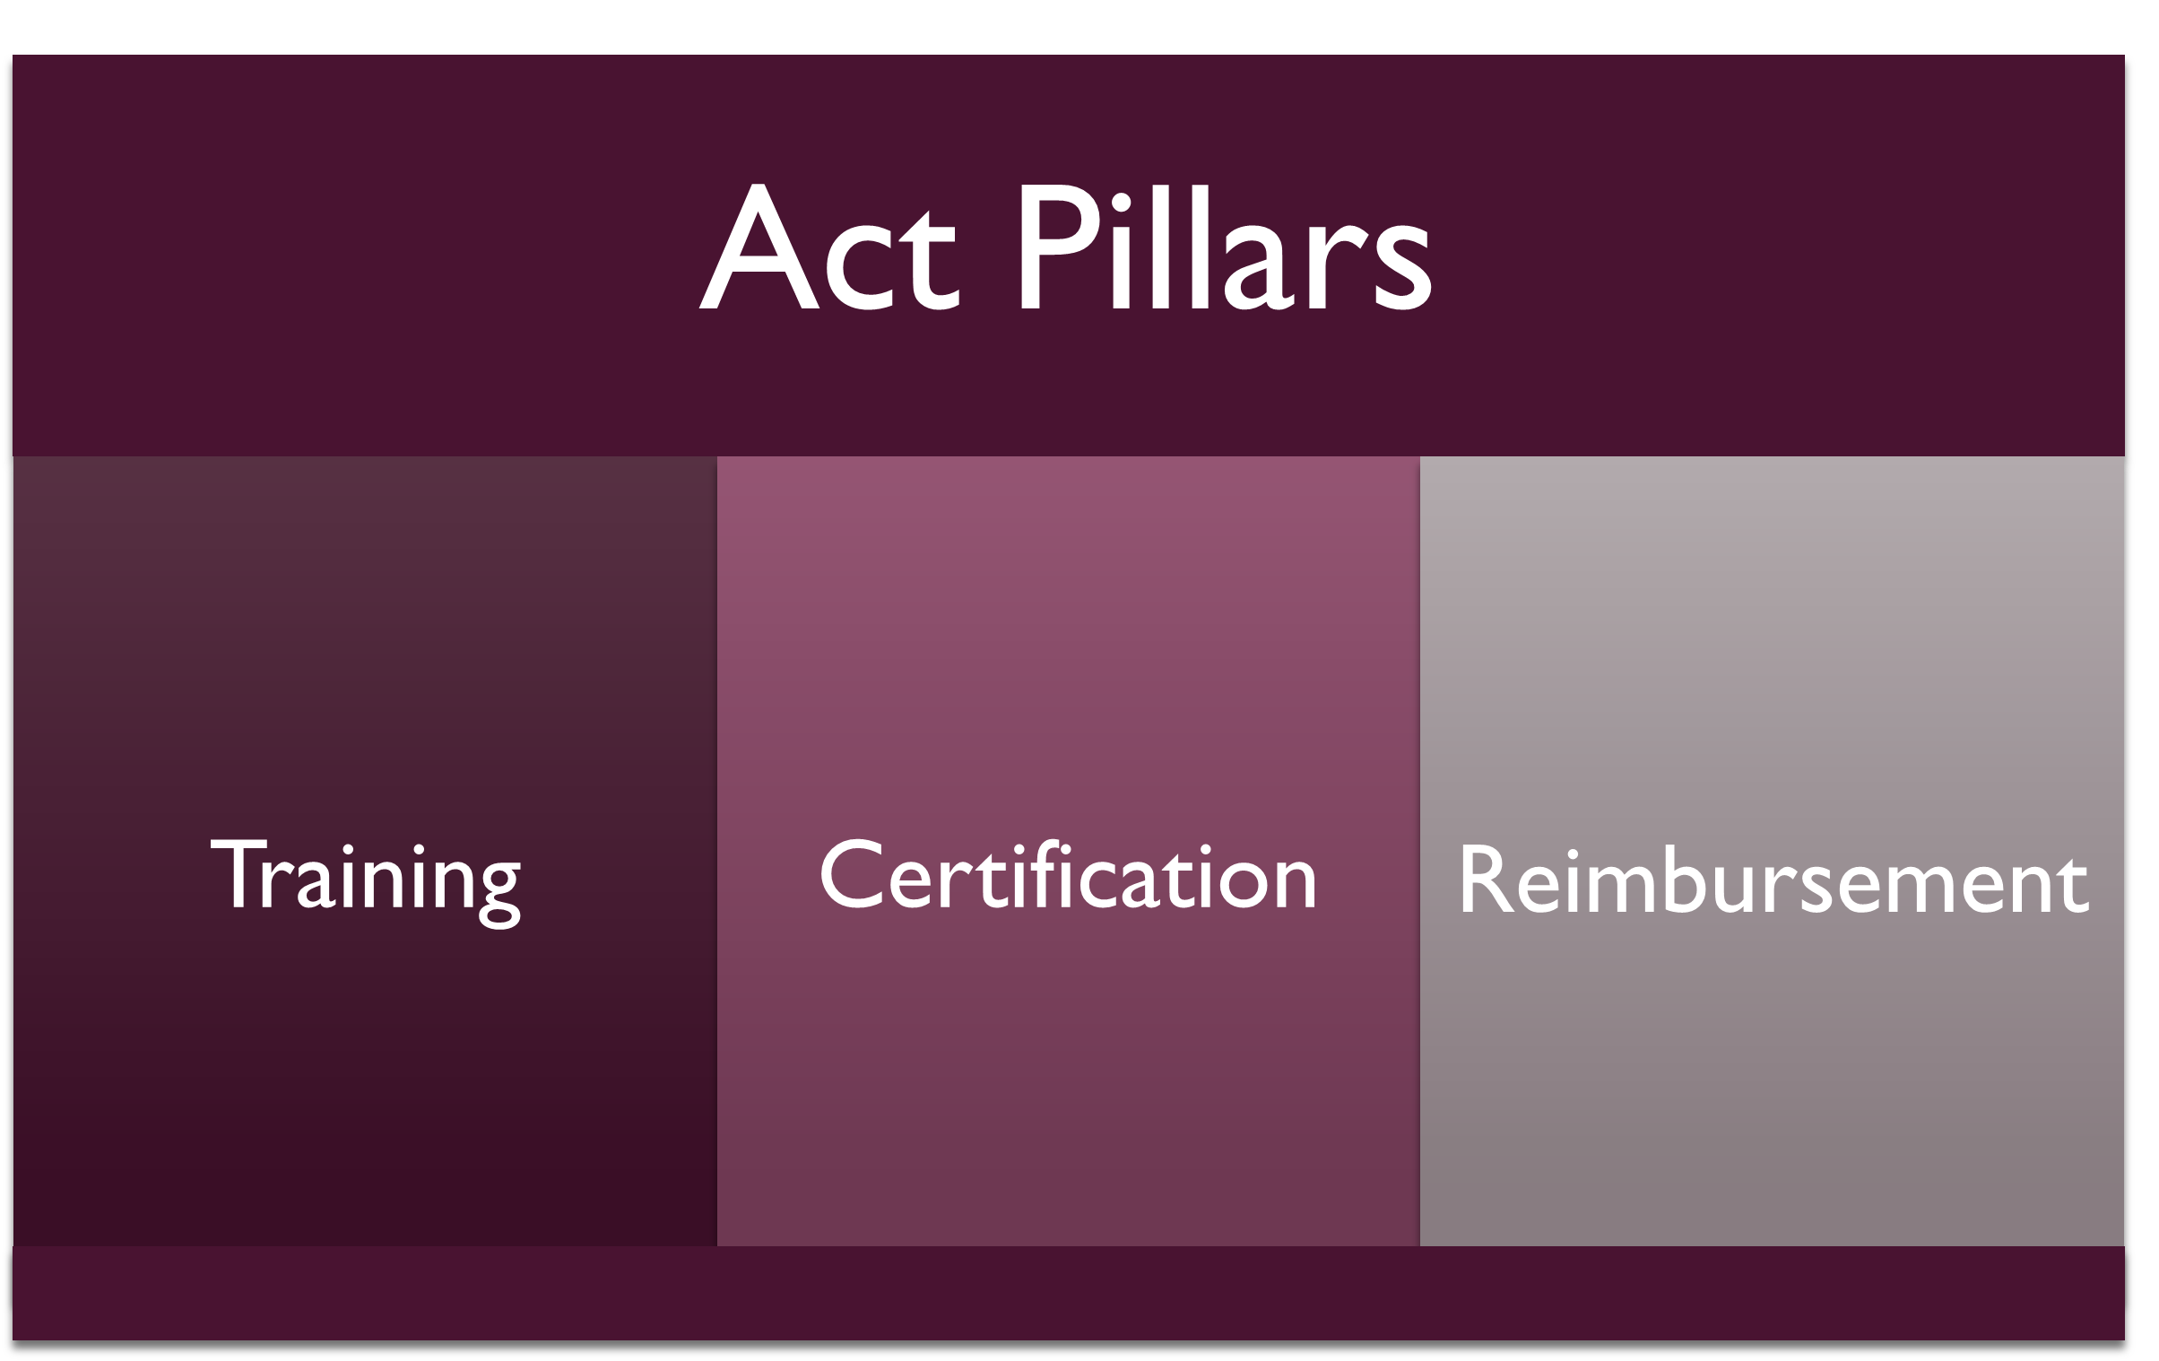
What is the Community Health Worker Certification and Reimbursment Act?
Developed in recognition of the importance of the community health worker workforce, the value they bring to advancing health equity, and the funding sustainability challenges this workforce faces
Passage led by the Illinois Black Caucus
Passed in November 2021

Slide 52
Reimbursement
Goal: to allow managed care organizations and medical program providers to receive reimbursement from Medicare/Medicaid for CHW services
Requires the Department of Healthcare and Family Services to develop a list of services to be eligible for Medicare/Medicaid reimbursement
including, but not limited to, care coordination and diagnosis-related patient services
Requires HFS to seek approval from the federal Centers for Medicare and Medicaid Services to reimburse CHWs under Medicaid
To be reimbursed by Medicaid, CHWs must work under the supervision of an “enrolled medical program provider,” and be certified
State contracts with managed care entities will be amended to allow entities to employ CHWs or subcontract with community-based organizations that employ CHWs

Slide 53
Certification
Goal: develop rules certifying both individual CHWs, including those being grandparented in, and academic and community-based training programs, as well as service reimbursement recommendations
Creation of the Community Health Workers Review Board
Proposes recommend standards, reviews proposed regulations, and provides feedback about training programs and reimbursement schedules.
Staffed by IDPH, ILCHWA, political appointees, and other CHW stakeholders
Certification is not required for employment of community health workers. Noncertified community health workers may be employed through funding sources outside of medical assistance programs.

Slide 54
Progress to Date
CHW Review Board members are appointed
Board is reviewing the by-laws of the board charter
No further progress

Slide 55
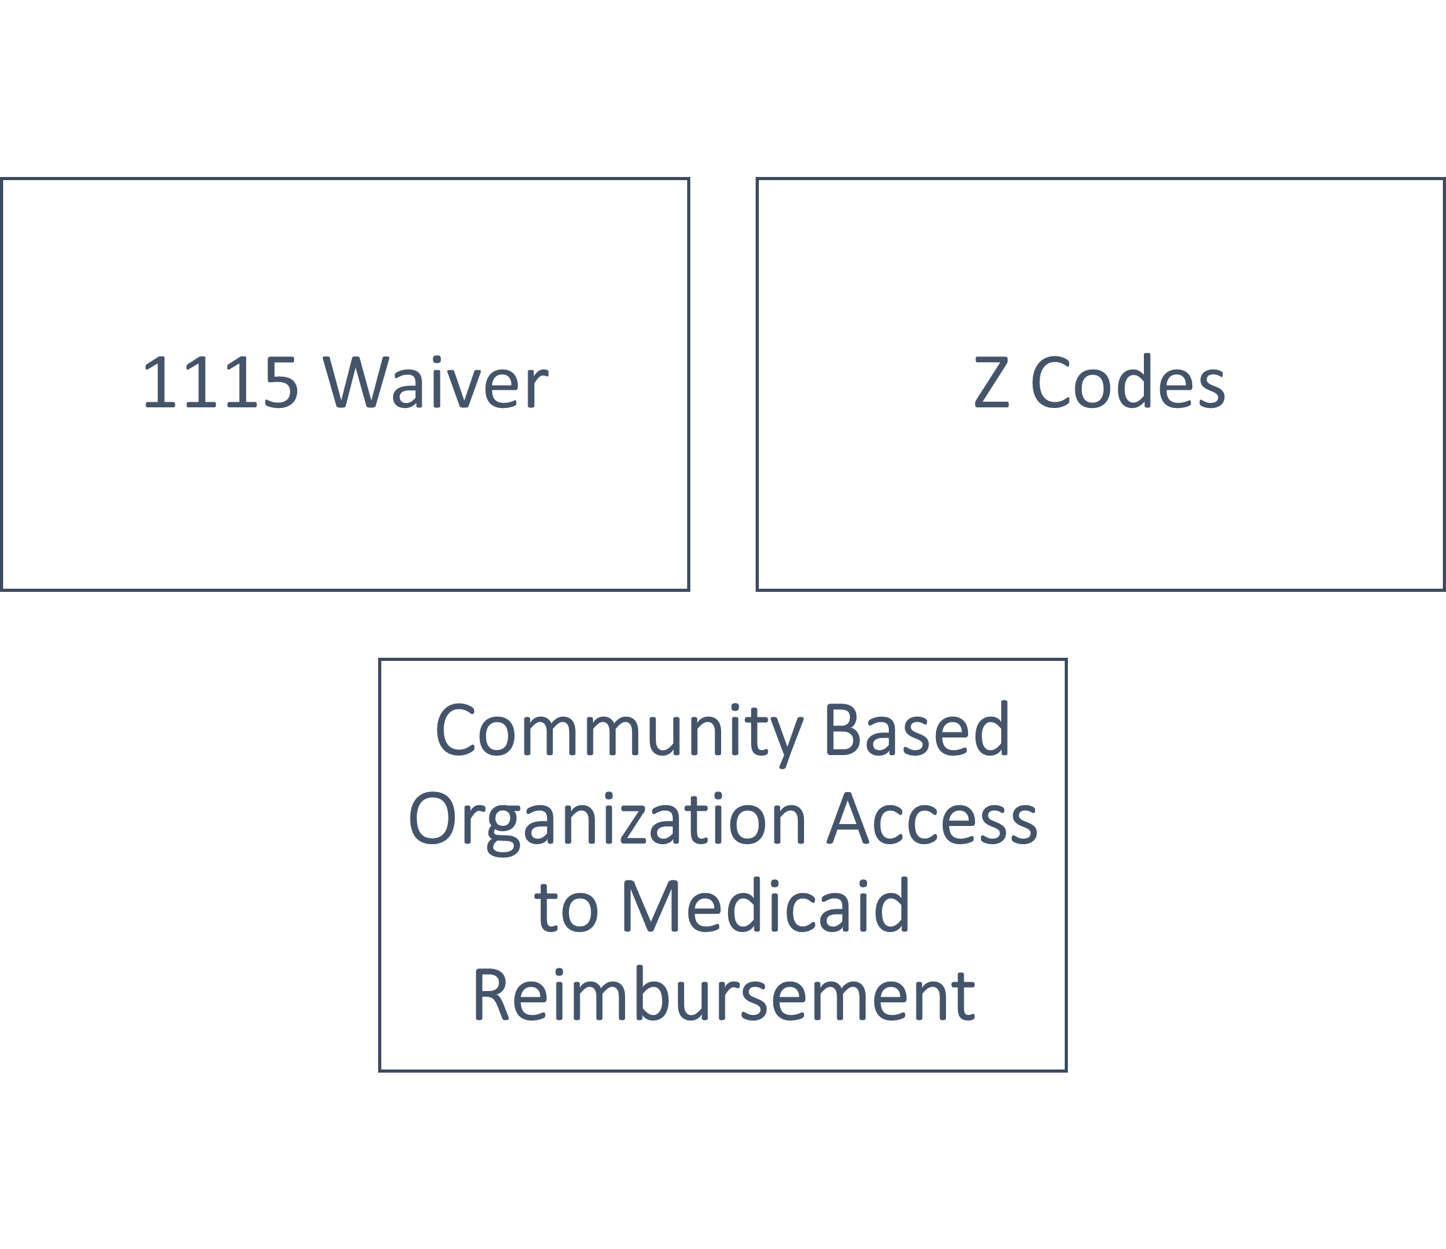
We’re Looking Into:

Slide 56
Limitations
Medicaid Reimbursement will not be perfect fix
CHW Review Board progress is slow moving
Limited Medicaid reimbursement access
Other untapped opportunities to explore:
Apprenticeships
WIOA/workforce funding
Medicare

Slide 57
Resources: How to Get Involved
Take Action:
Testimony to Review Board
Advocate for bridge funding: IDPH, HFS, DCEO
Sign on to ILCHWA advocacy
Attend:
ILCHWA’s Workforce Development committee meetings
Email: ilchwa2018@gmail.com
Public Health Workforce Collaborative meetings
Email: Anna Yankelev, ayankelev@hmprg.org
National Association of CHWs (NACHW) Policy Committee

Slide 58
Q & A

